Slide 1
PICCO
Details of Picco

Slide 2
During growing time for plants, a large of agriculturists used some chemical to kill the insects widely.There are more than 200 chemical prevention substances were produced. And there are many ways for chemical prevention substances work for preventing insects.
Such as stop sloughing off for insects.
Stop the caterpillars to grow up.
Destroyed the digestion cells.
Stop fat cells to grow up.
Stop growing in ATP.

Slide 3
Absolutely, there are 4 levels for chemical insect prevention substances such as the most dangerous, more dangerous, dangerous and the least dangerous. This is very important because these chemical substances are also harmed all plants. So these will prevent the growth of plants. If you sprayed it in a large amount, it would caused plants died.
-Picco was produced for this case. The main substance is fatty acid, which is non-toxic and produce from palm oil. With the special processing, the fat is able to mix completely into water. So Picco is one of the choices for agricuturists.
-Because of Picco is non-toxic, the agricuturists are able to breathe, touch, or spray safely. This is all safe for human and mammals.

Slide 4
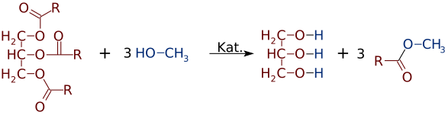
The main substance in Picco is fatty acid methylester.
Molecular Formula CH3(CH2)nCOOCH3

Slide 5
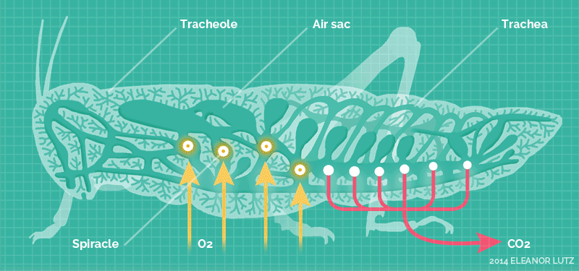
Method of Picco is stopping insects respiration.
Trachea is 1) Air sac : respirate organs for insects and some of arthropods, which is next to the respirate pipe, spreading all body for transferring.
2) Spiracled : the pipe is inside the neck of vertebrates, which gas flow to the lungs for inhale and exhale.
*** Tracheole is small tube.

Slide 6
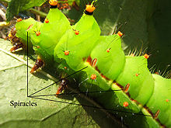
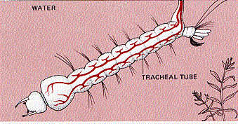
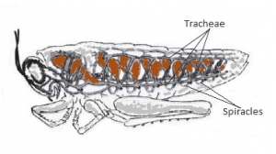
Spiracle is pipe or way which is an open-air of the trachea for insects and arthropods breathing .

Slide 7
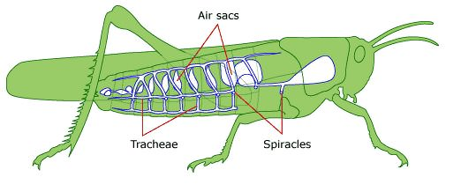
Trachea
-Higher phylum such as arthropods, we can use insects such as crickets, grasshoppers or cockroches as example for experiments. The stomach area, we can see small holes, which is call spiracle. Actually, there are 10 spiracles. 2 for chest and 8 for stomach. After spiracle ,deeper inside, there is trachea, which is cleared and small. It is flexible as spring when the air flows through the tracheole. Until the smallest and thin pipe which touches the body cells. The end of the pipe covered with liquid. The oxygen from trachea would melted into liquid and spreaded to nearest cells.
-Because of the transportation system for insect is the closed-system, there is substance which is called hemocyanin, is able to absorb the oxygen. The blood circulation is almost do not need to transport oxygen to the cells because of trachea system is able to transport to issues and also insects movement causes of trachea is flexibly. So this helps the air transport well into system.
-The trachea walls are strong, contains cuticle, so it is able to be in shape.
-Some of insects contained big air sacs to keep the air transport well. For example ,grasshopper is able to extend and shorten the stomach muscle to get the air both inhale and exhale. In case of bigger insects ,there is not enough air pressure to transfer the gas to the end of tracheole, which is limited insects size.

Slide 8
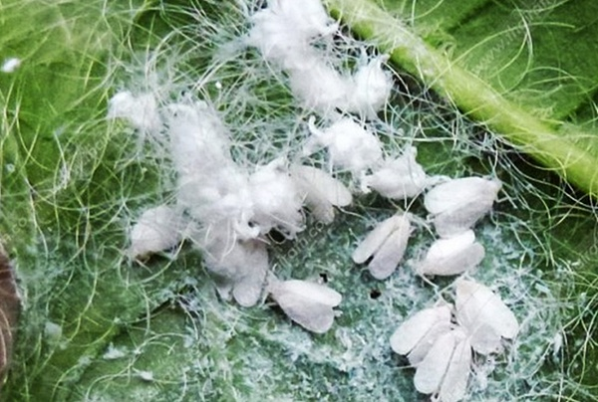
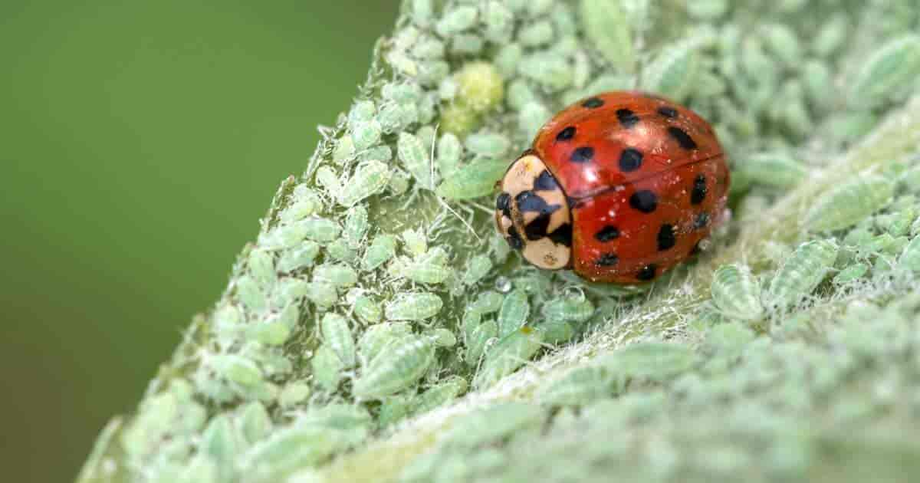
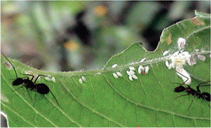
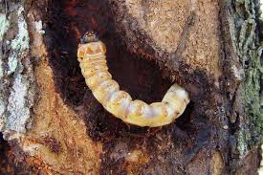
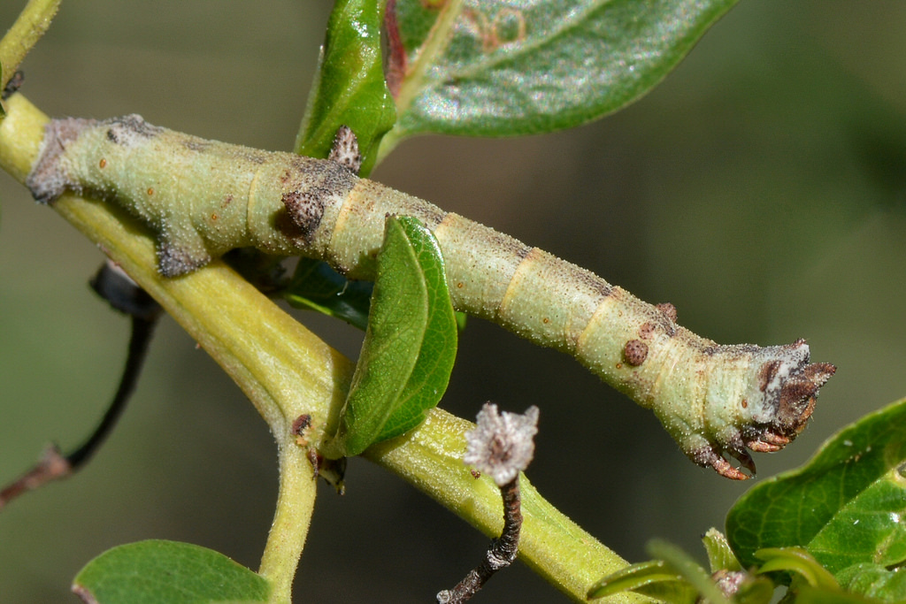
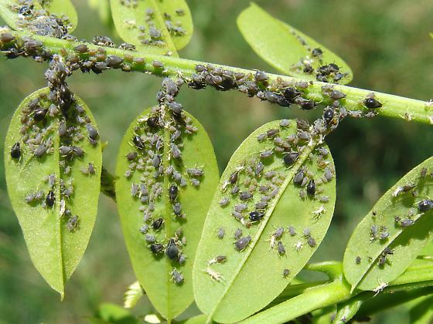
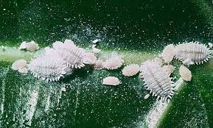
This makes Picco able to killed many types of insects widely such as plant loses and worms. Also able to killed many of growing system. For example, eggs, caterpillar and some of metamorphosis.

Slide 9
Amount for using Picco
Prevention Period : Mixing Picco 150 cc Soluble in water 100 L / 1 Acre
Infection Period : Mixing Picco 250 cc Soluble in water 100 L / 1 Acre
Spreading Period : Mixing Pesti-Max 350 cc Soluble in water 100 L / 1 Acre
*Amount for mixing depended on amount ,density, area, age, height and size of plants.*

