Slide 1




The Power of Organic
Present by The Sun Farm

Slide 2
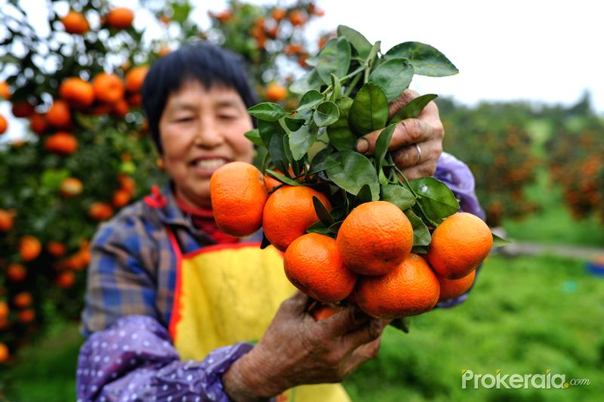
Main Theme of Organic is :
How to create food from ‘EMPTY’
From ‘EMPTY’ , We can create food by
Using Human power + Natural Power
That mean :
“We must trust in NATURAL”

Slide 3
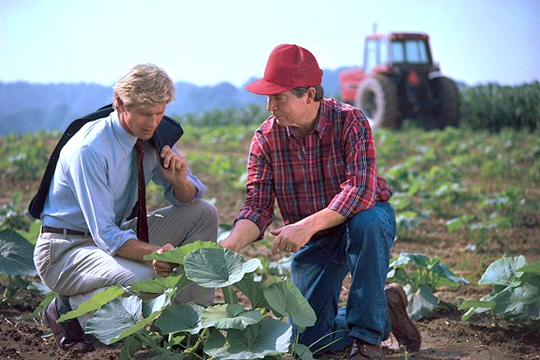
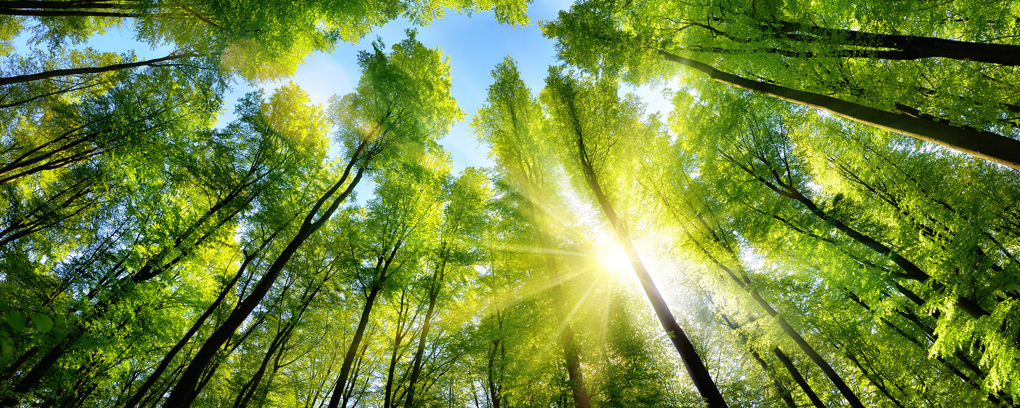
Human Power , we use knowledge , manpower , experience
Natural Power , we use soil , wind , fire , water

Slide 4
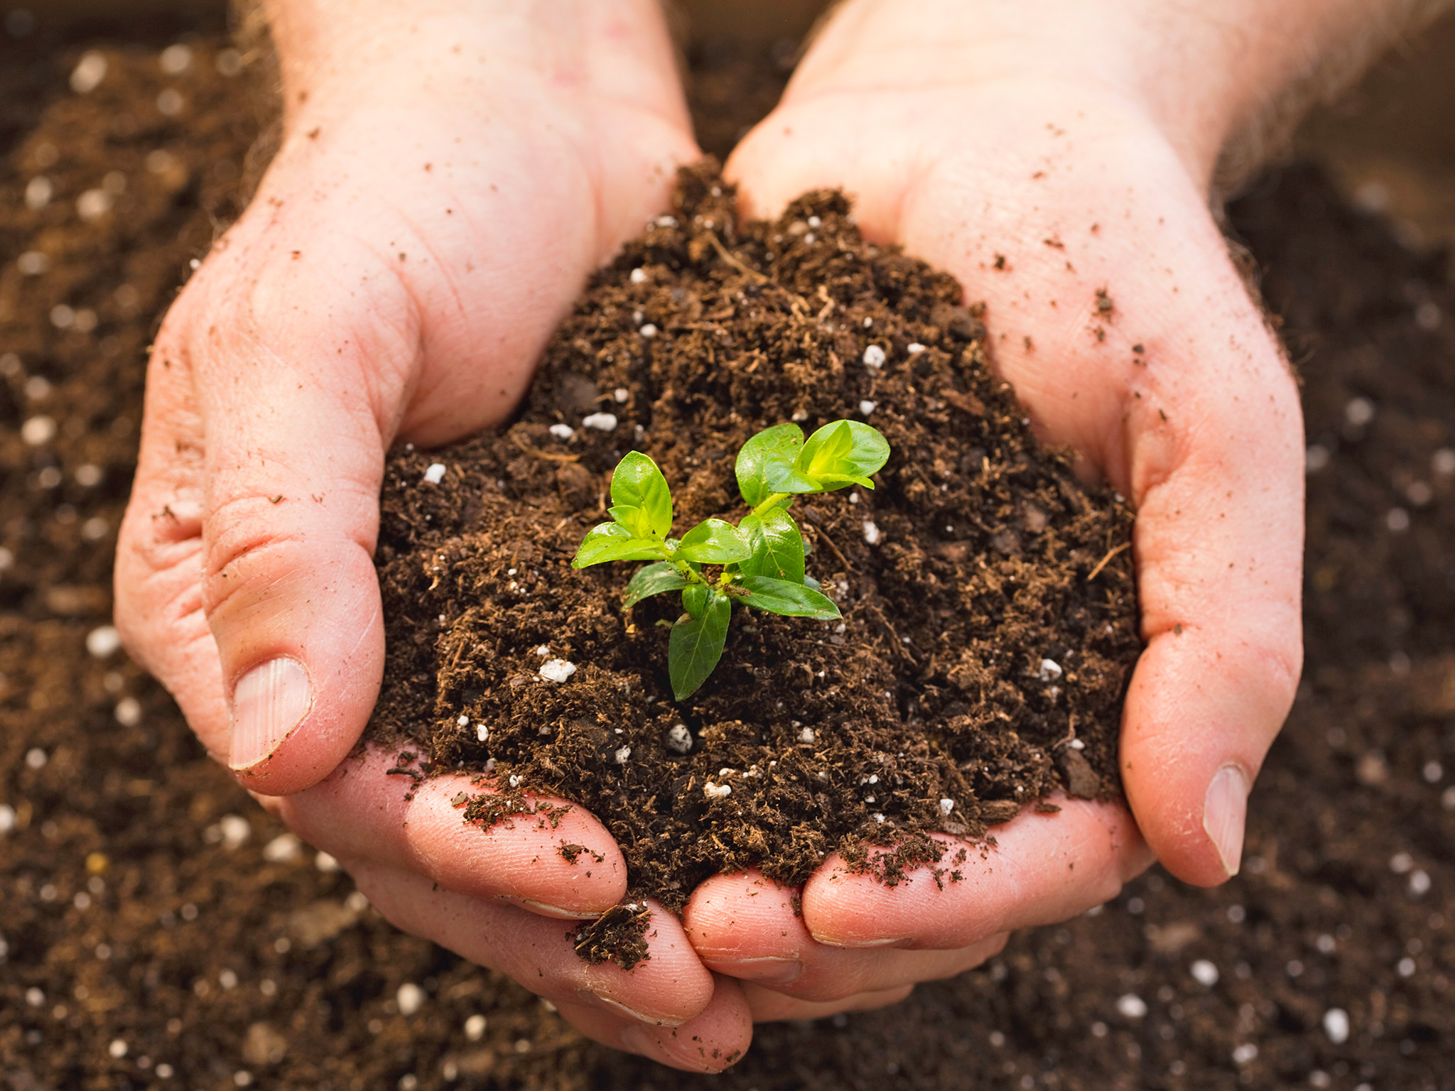
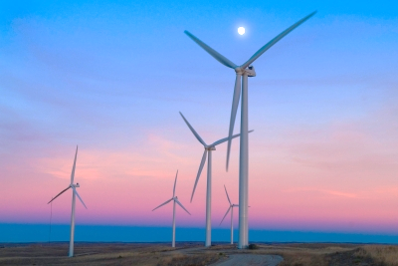
Soil have many MINERAL
Ca
Mn
P
S
Mg
K
Fe
Zn
Bo
Wind have much GAS
Carbondioxide
Oxygen

Slide 5
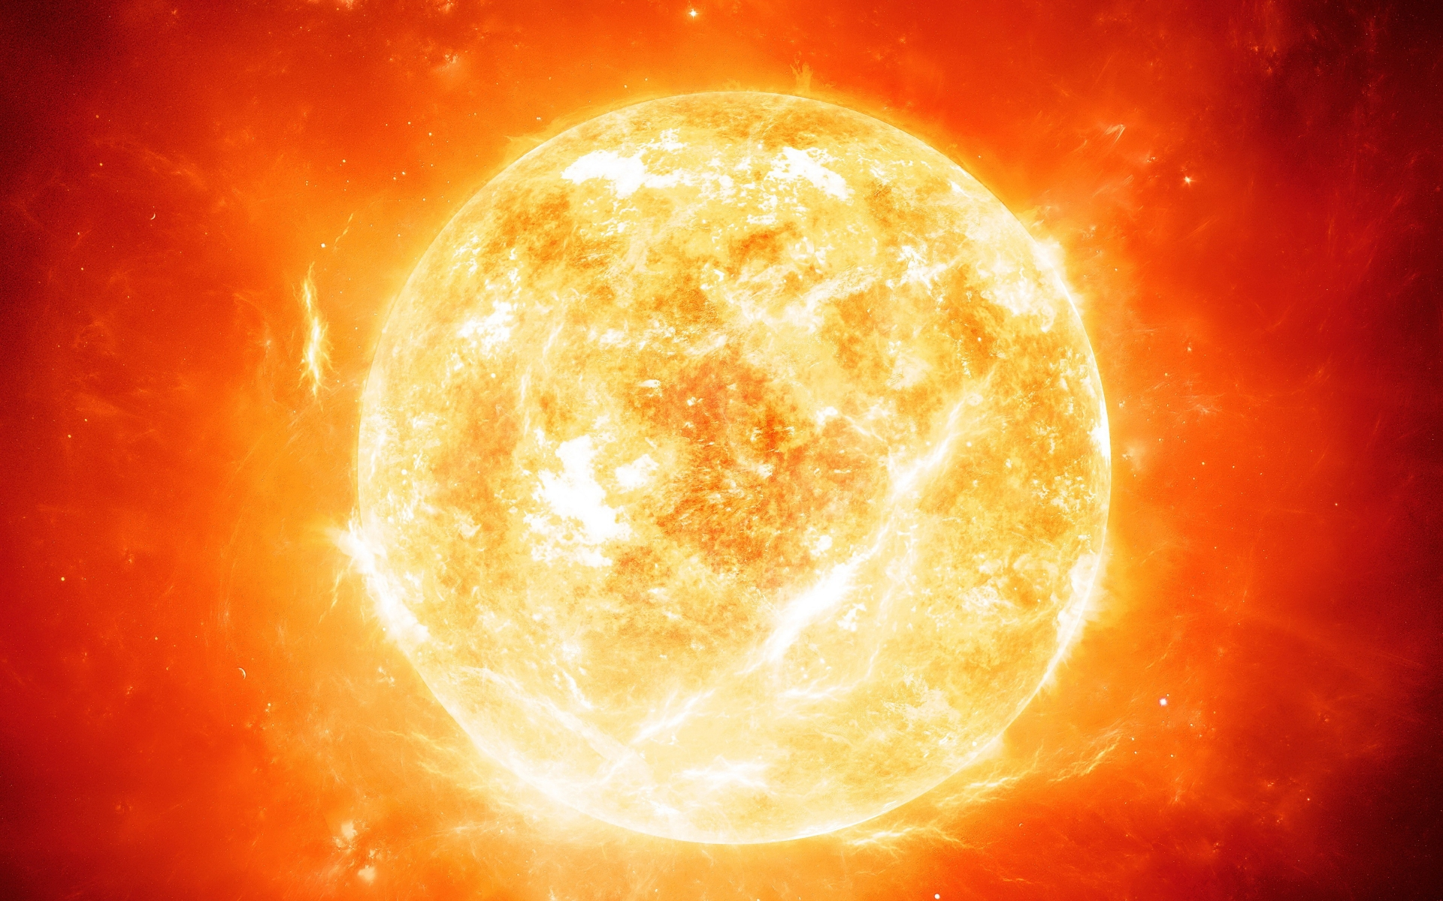

Fire have eternity ‘Energy’ from ‘The Sun’
Water have elements that create a life ‘Purity Liquid’
Hydrogen
H2O
Oxygen

Slide 6
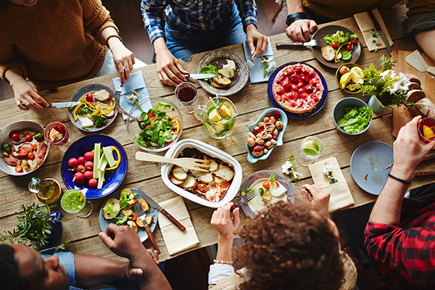
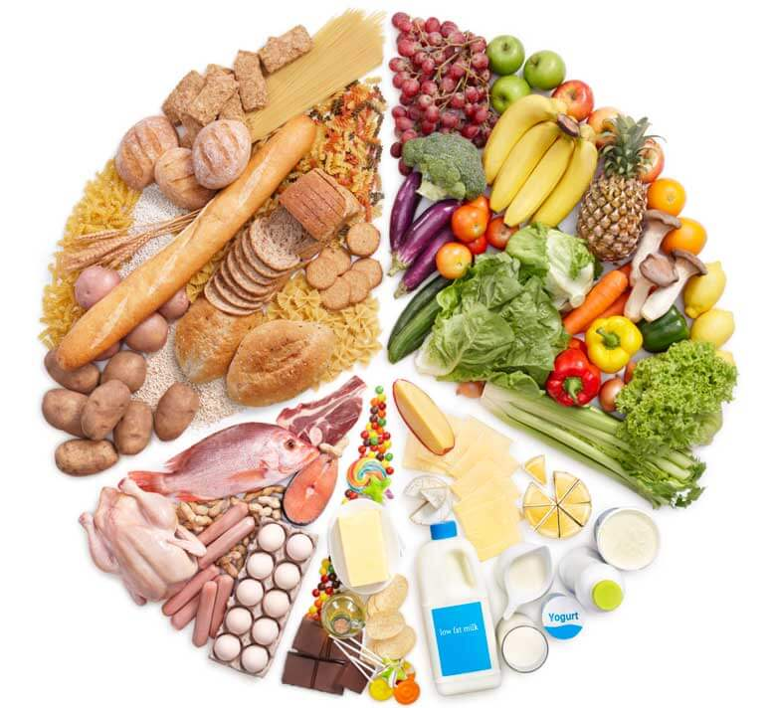
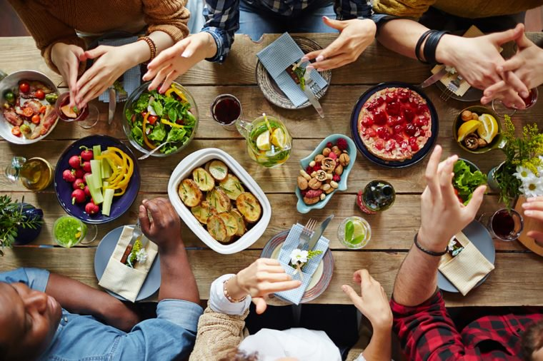
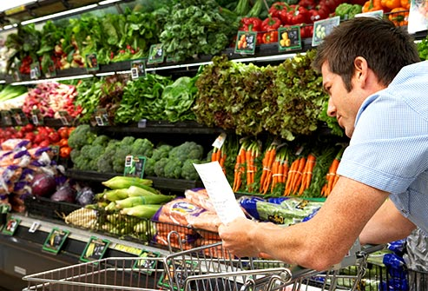
With all of those condition
We create ‘simply food’
‘organic food’
‘safety food’
‘value food’
‘healthy food’

Slide 7
Is it too hard ?
“So , come and take it the easier way”

Slide 8
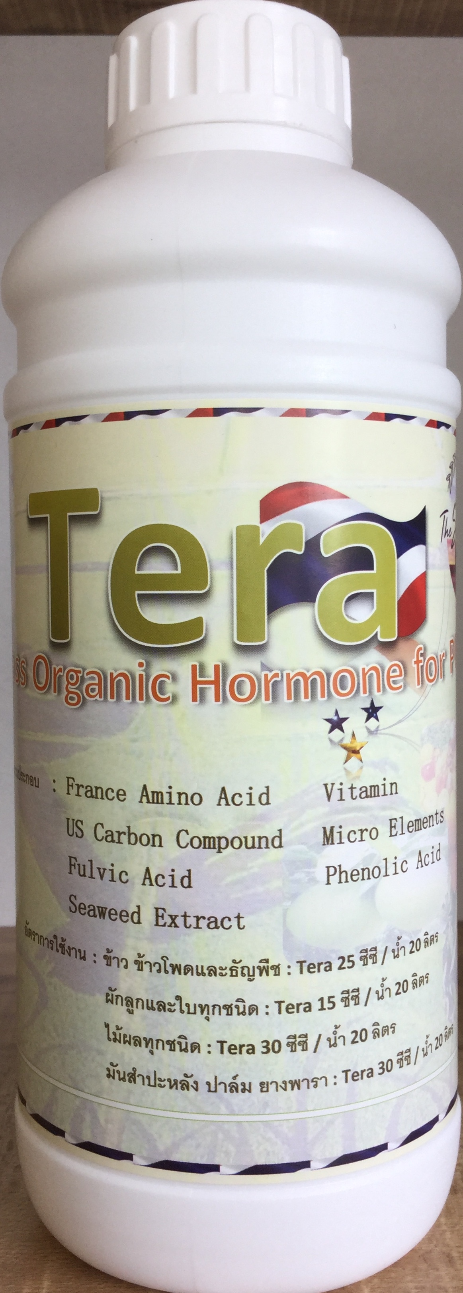
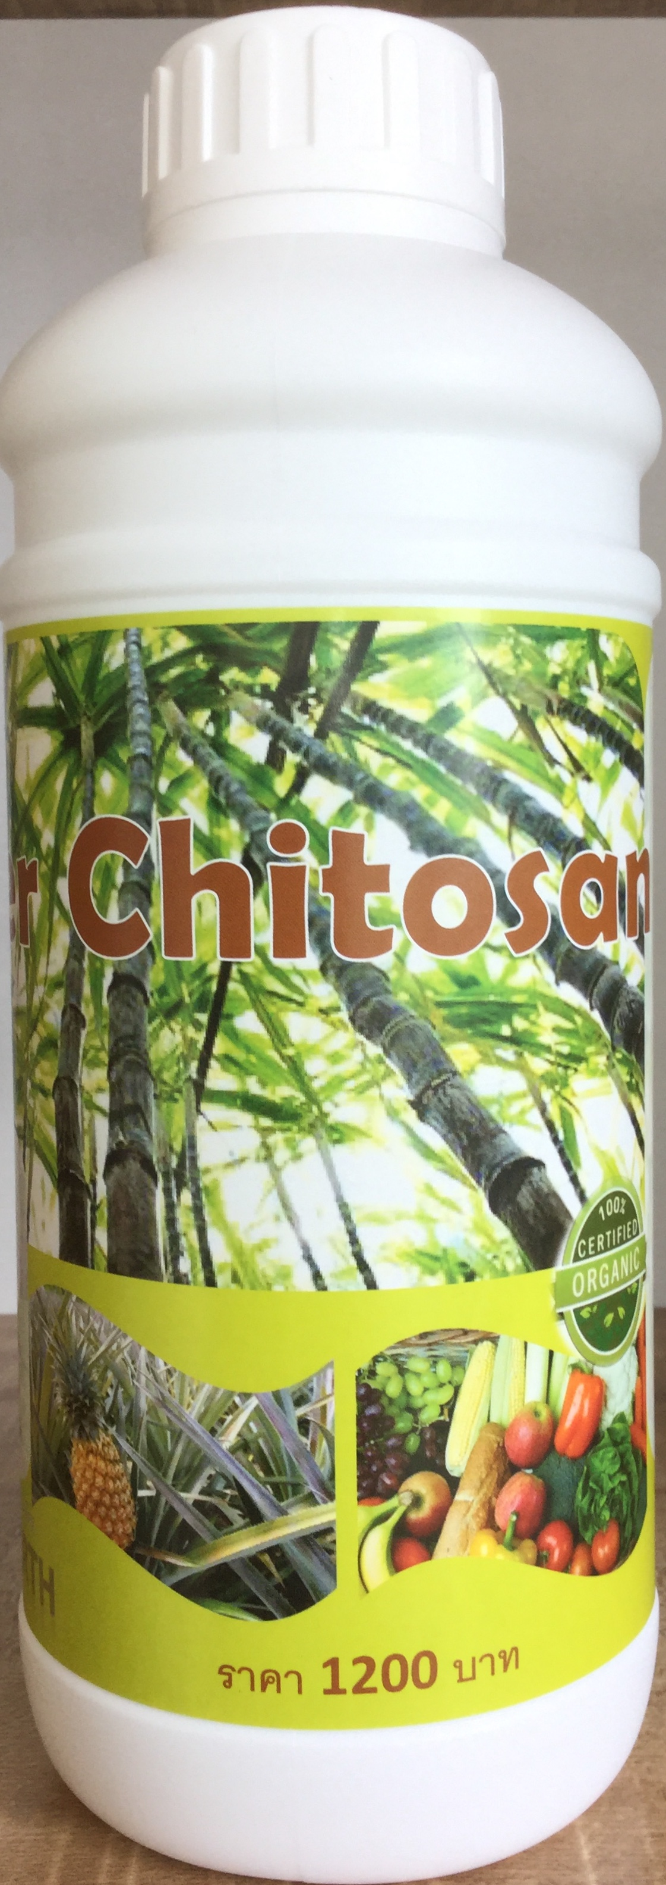
We create root , stem , trunk , leaf with these product.
-High of amino acid 17 types
-Carbohydrate
-High of ‘Organic Nitrogen’
-Carbohydrate

Slide 9
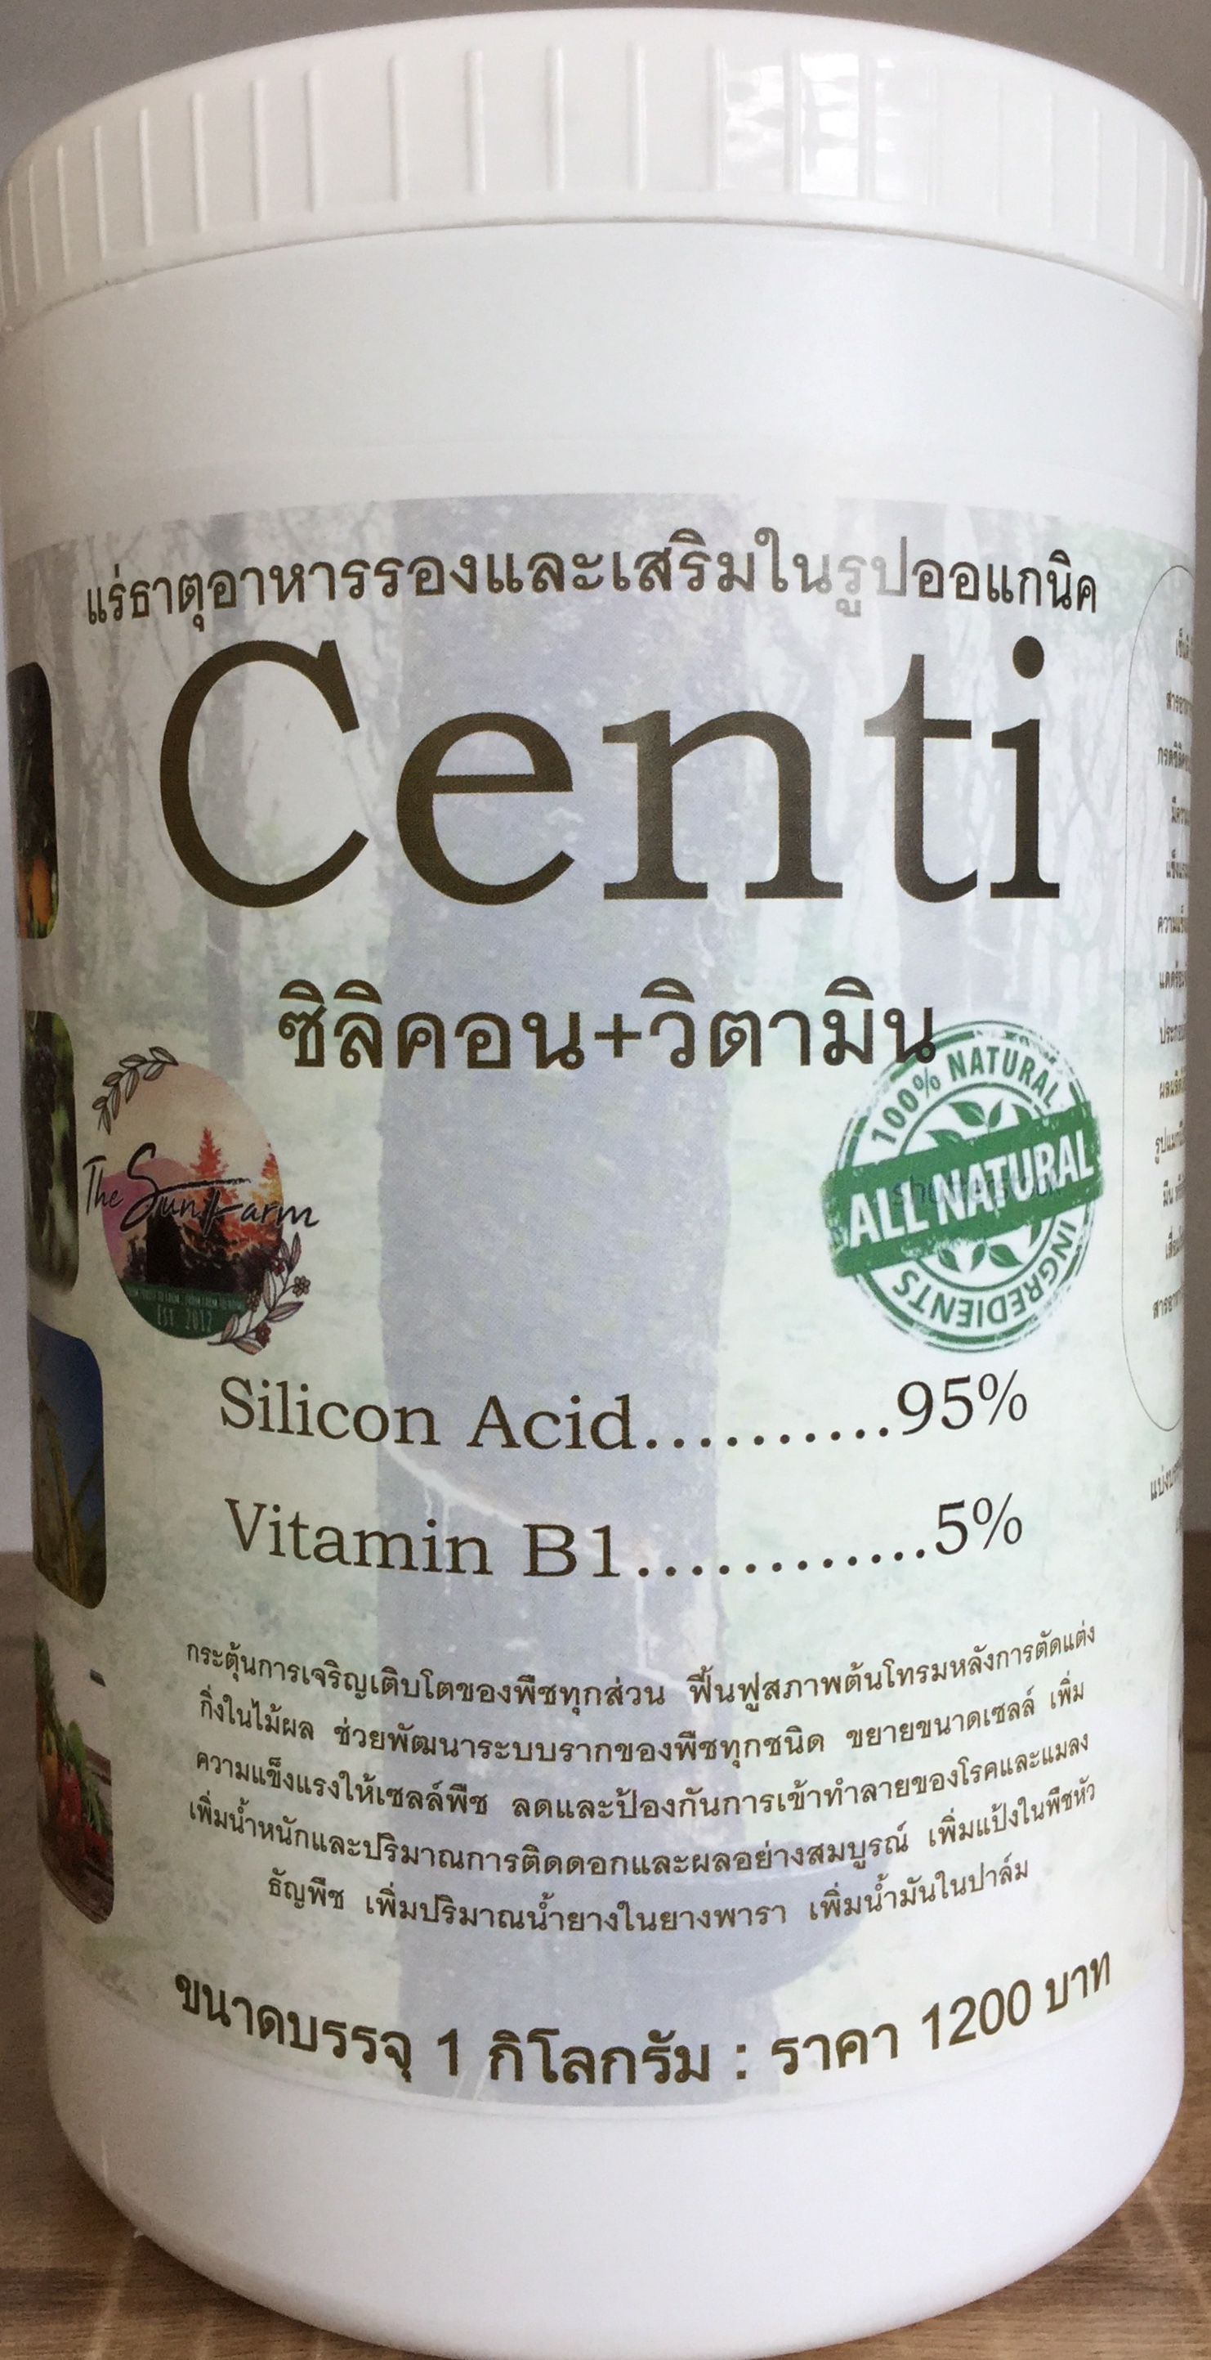
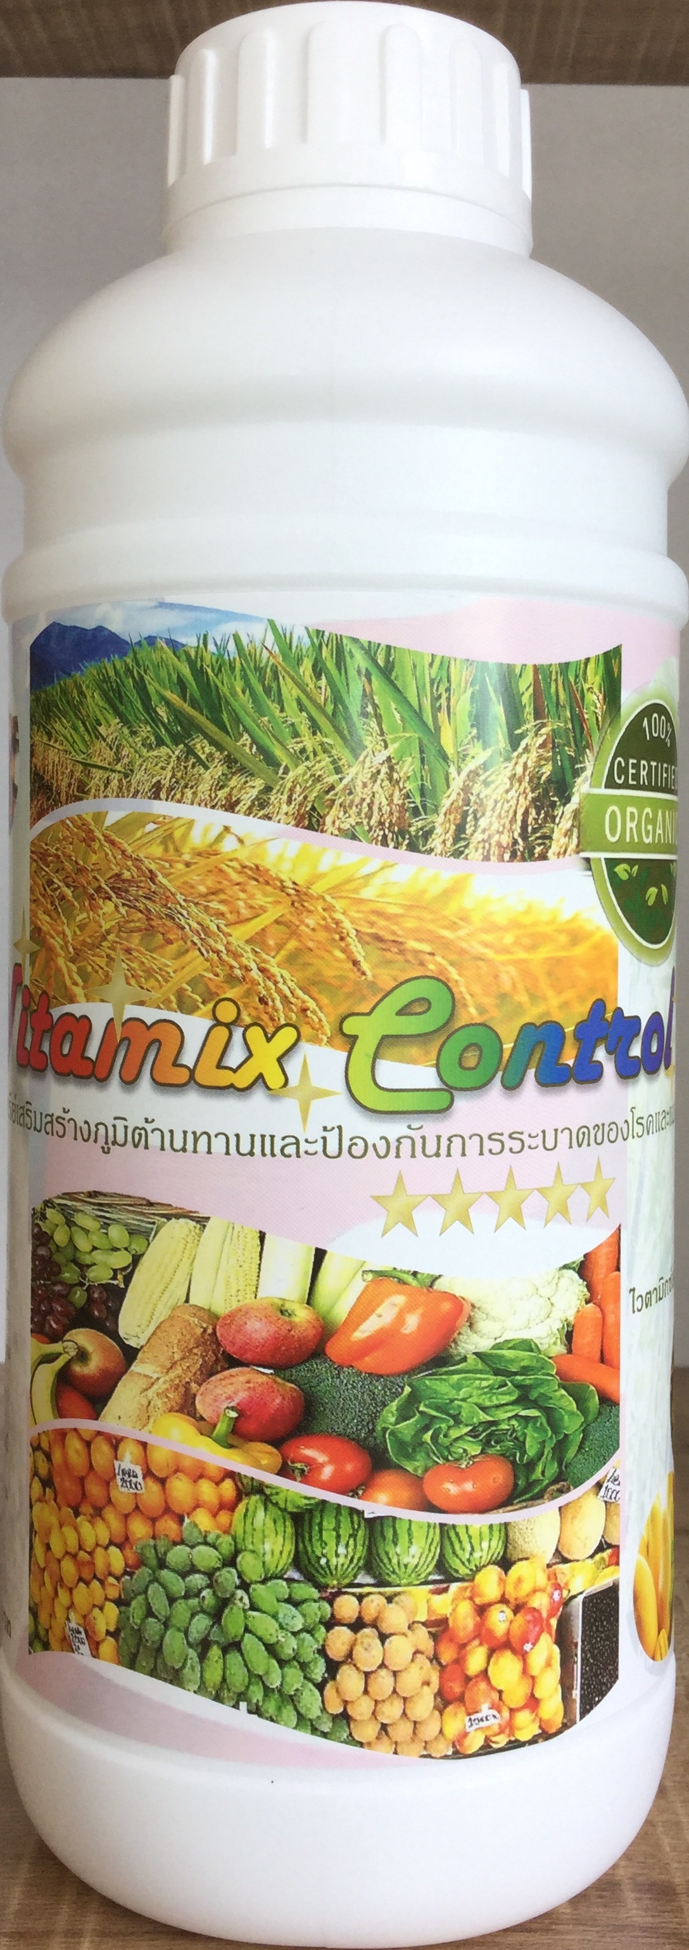
We create resistance , tolerance , hormone , color , quality with these product
-High of many types mineral ; calcium , boron , magnesium , manganese , potassium , iron , zinc , sulfer , phosphate
-High of vitamin , organic acid

Slide 10
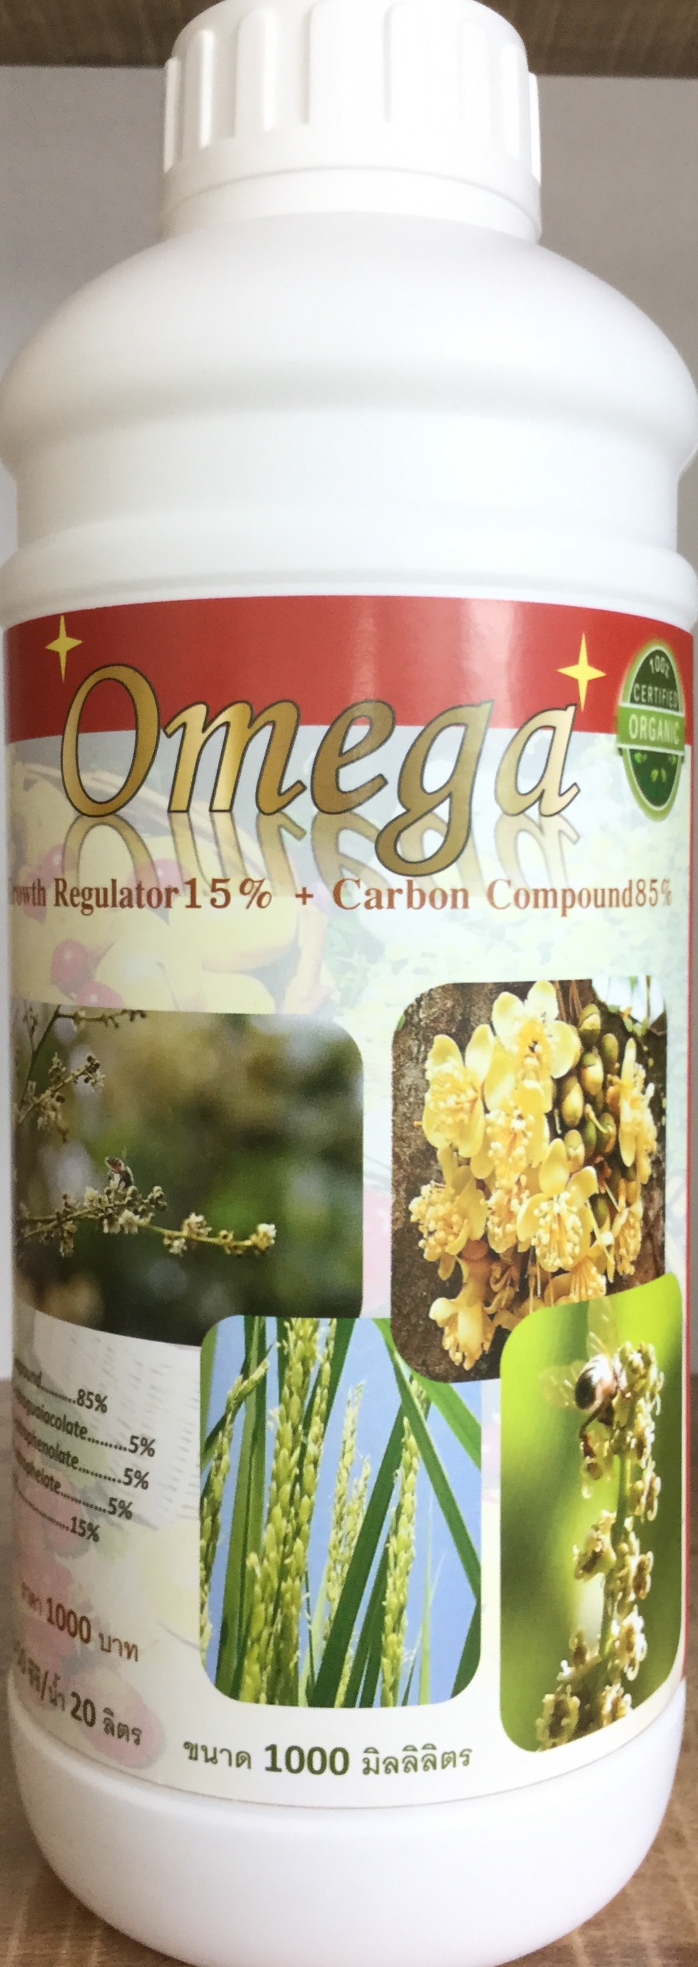
If you need create fruit off-season , must use this product
-High of hormones
-High of vitamins
-High of Carbon
*** you must use ‘CARBON’ element to make fruit.

Slide 11
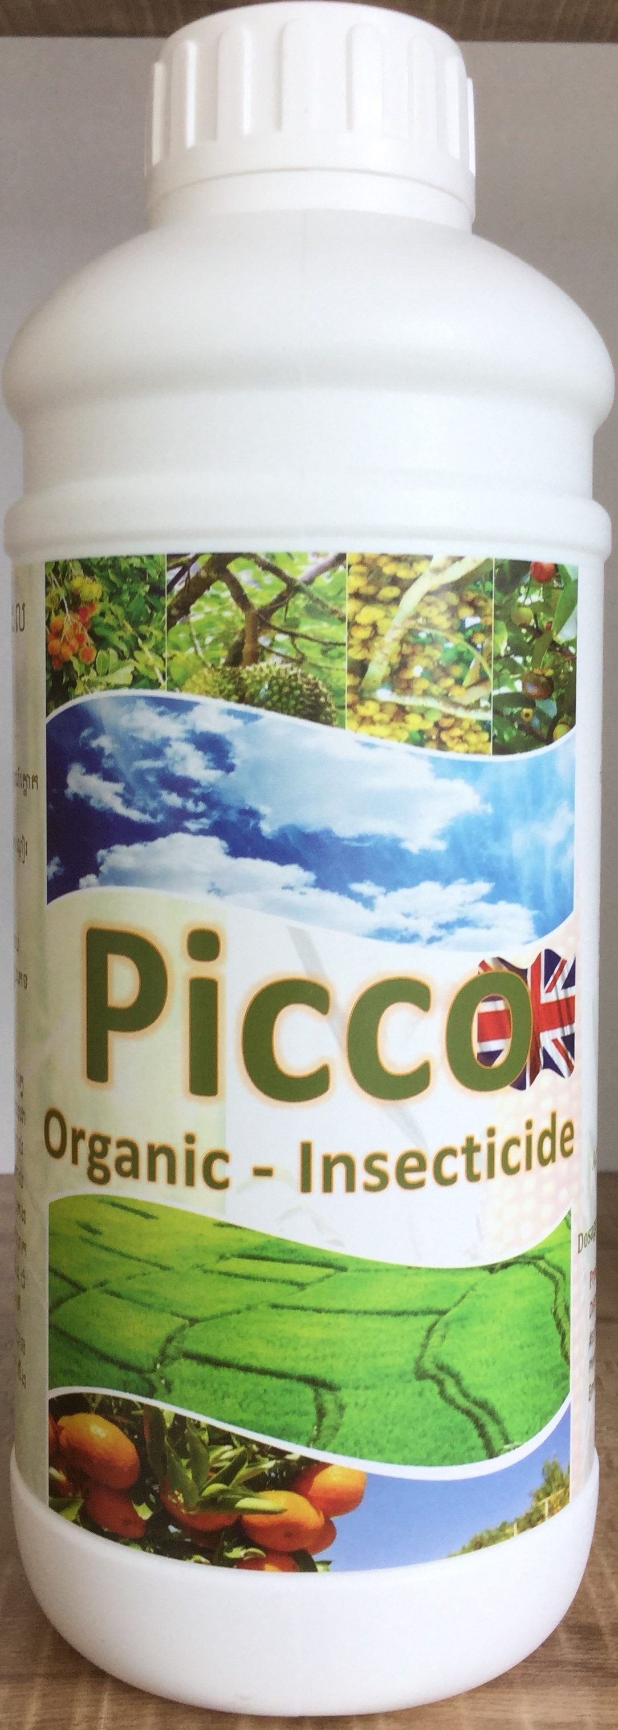
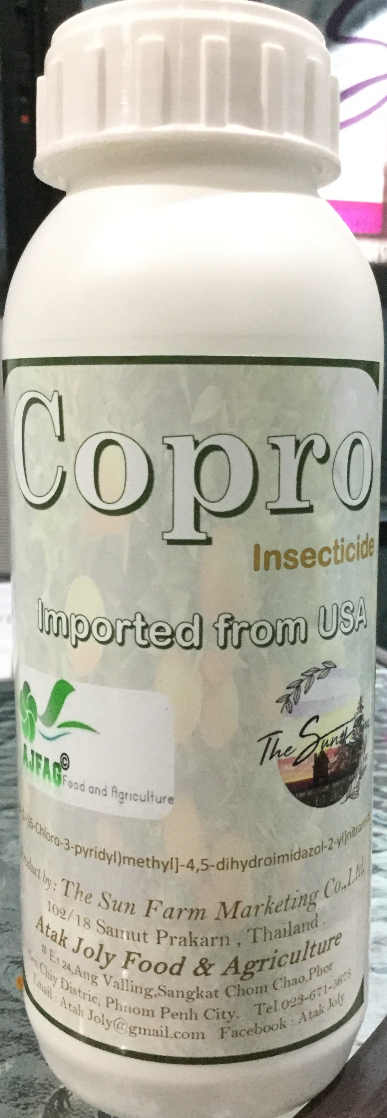
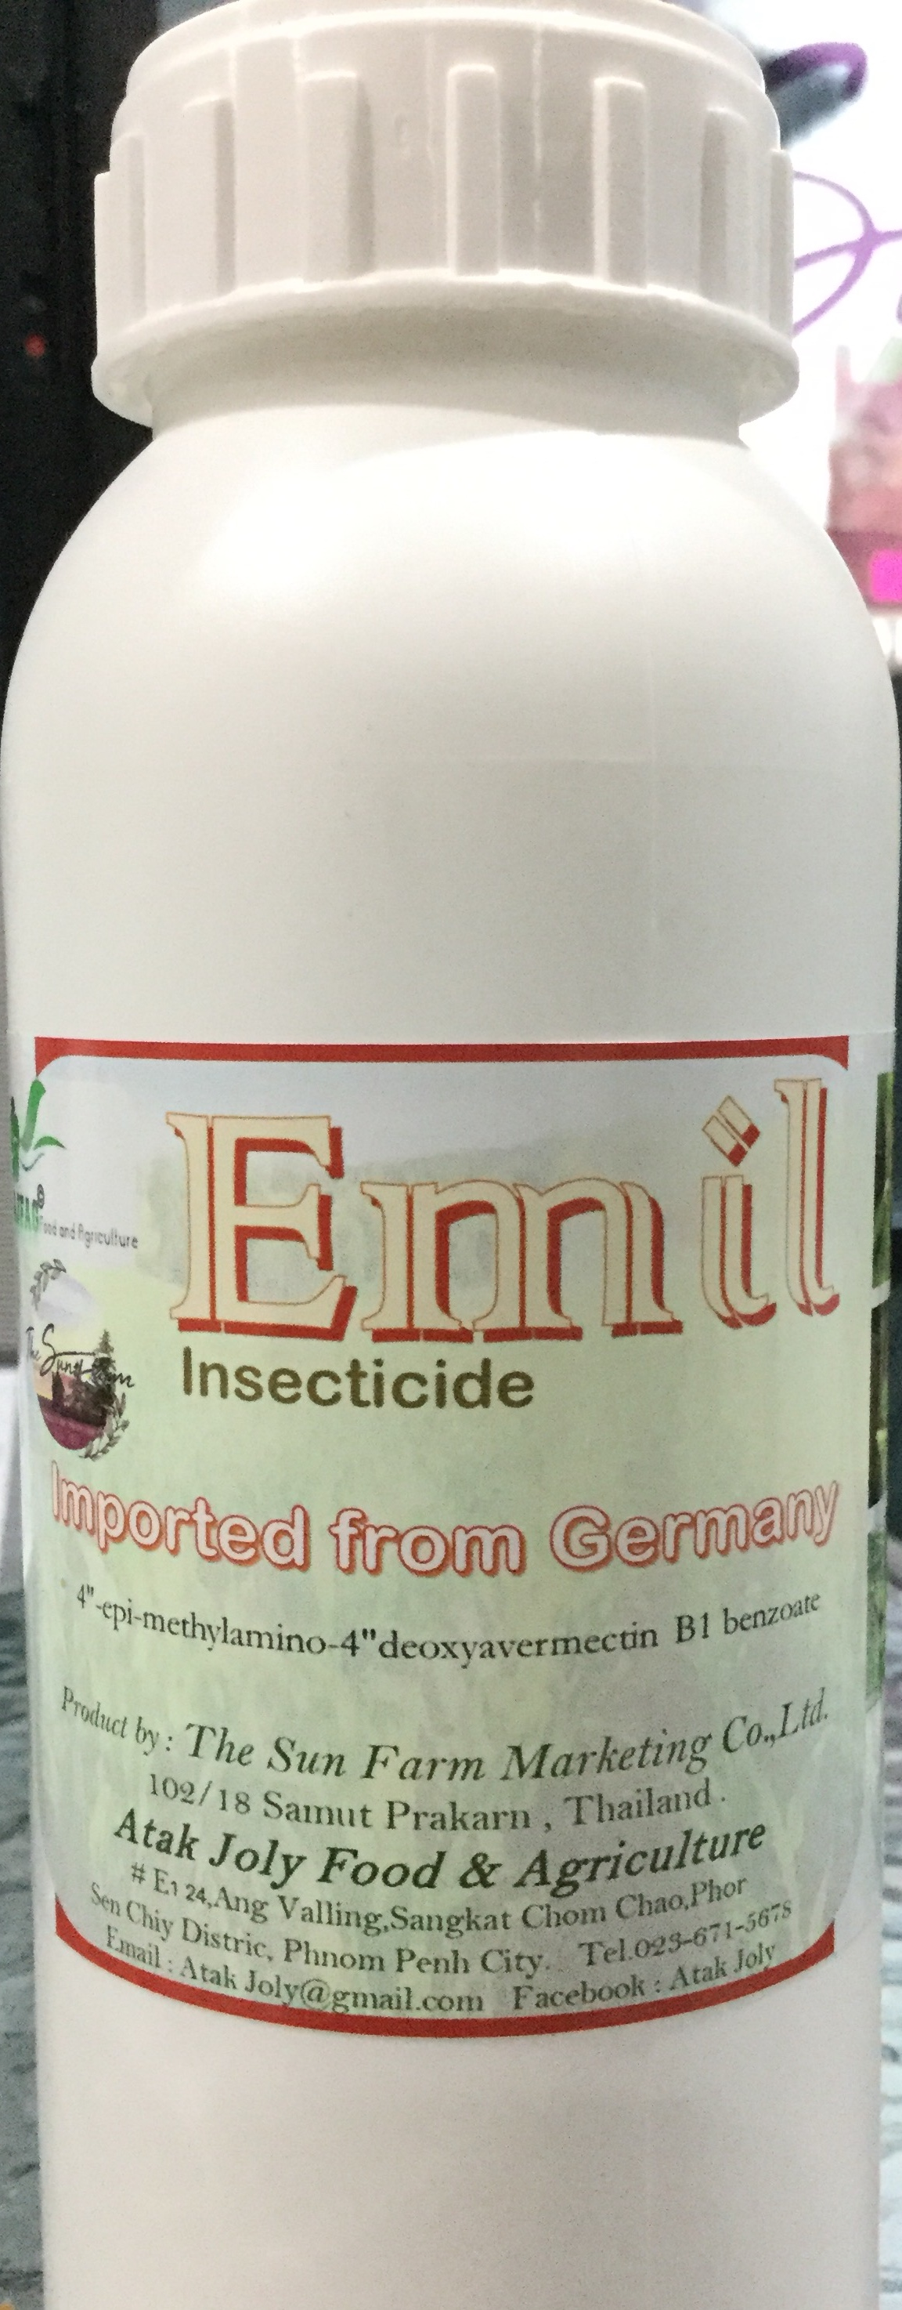
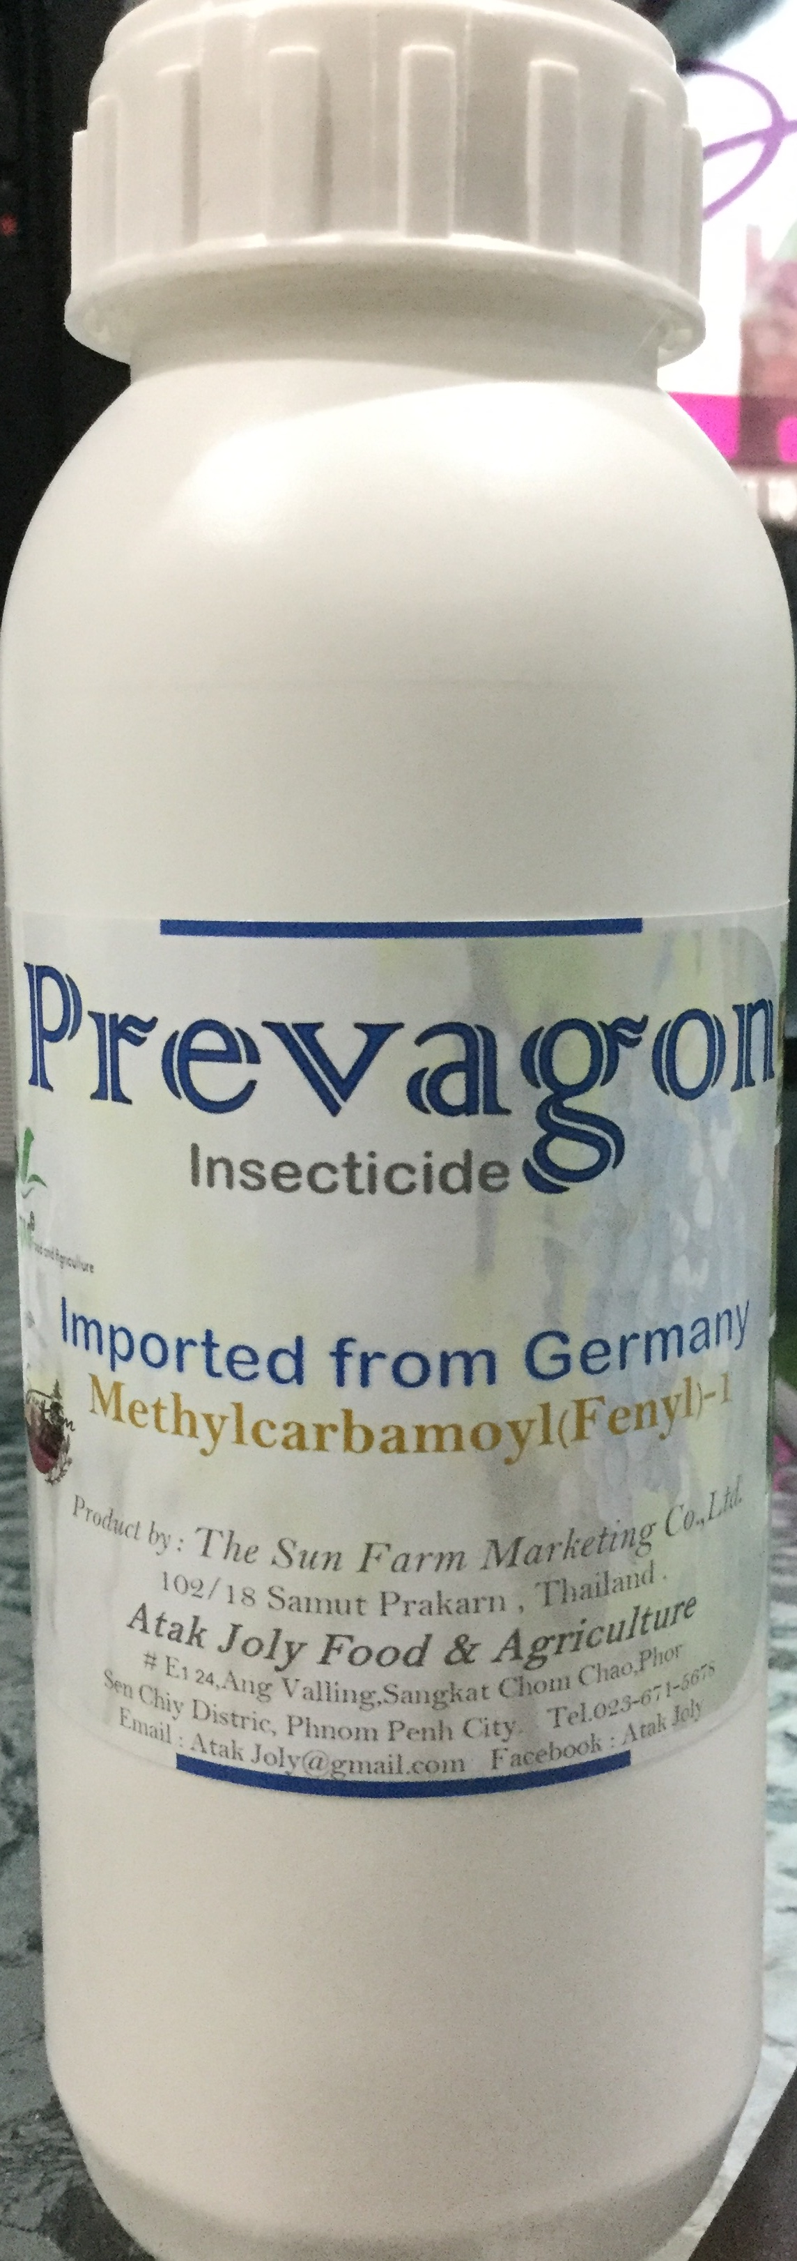
To protect plant from insects
-non toxic
-safe for human ,
Livestock , pet

Slide 12
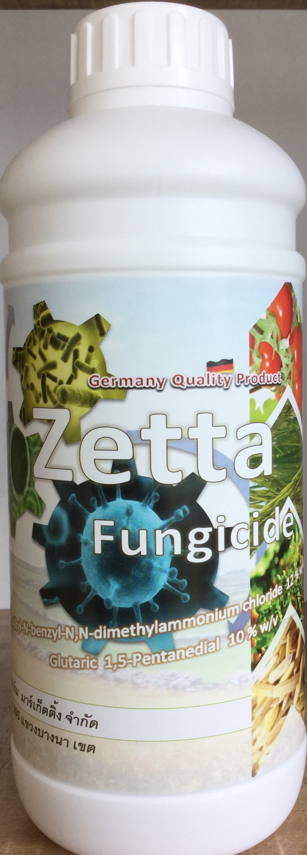
To protect plant from disease
- Fungus
-Bacteria
-Virus
-kill various disease
-safe money
-safe life
-safe crops

Slide 13





“Now,we can create ‘FOOD’ easier”
Cambodia
Thailand

