Slide 1
ZETTA
Details of ZETTA

Slide 2
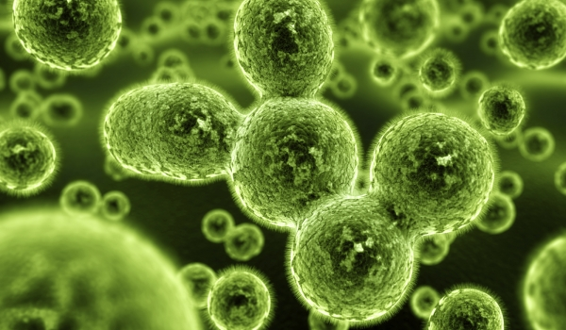
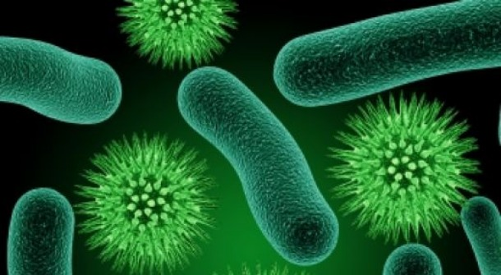

There different type of pesticides such as fungal , bacteria and virus. This makes the farmer need to buy several products.
Most importantly pesticides got variable strength from mild to potent. The more potent ,the more expensive.

Slide 3
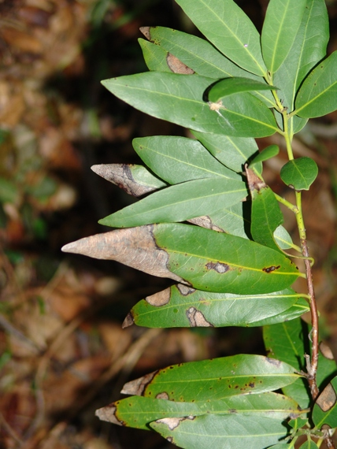
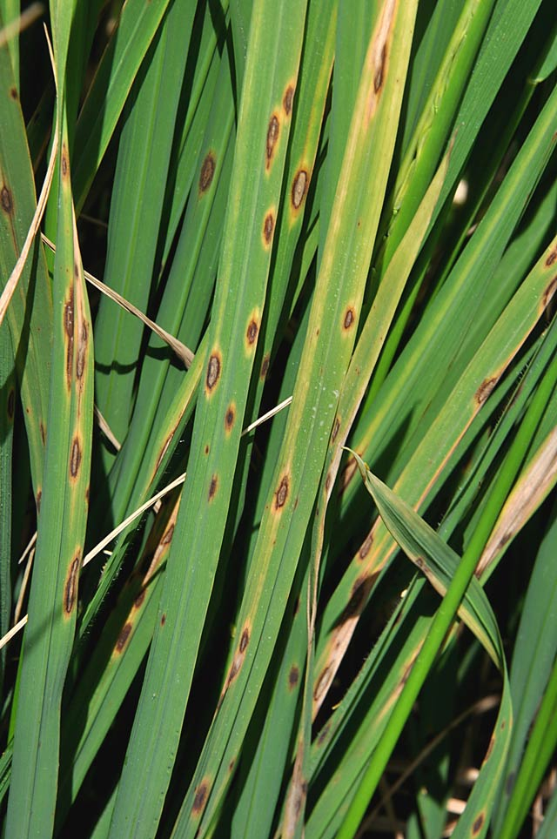
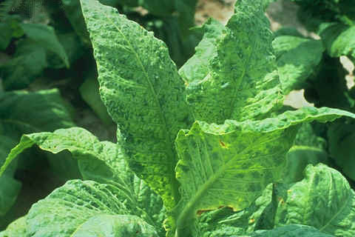
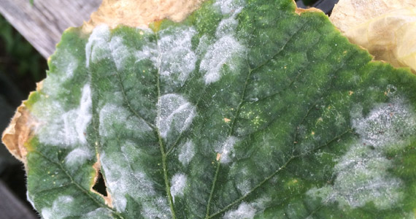
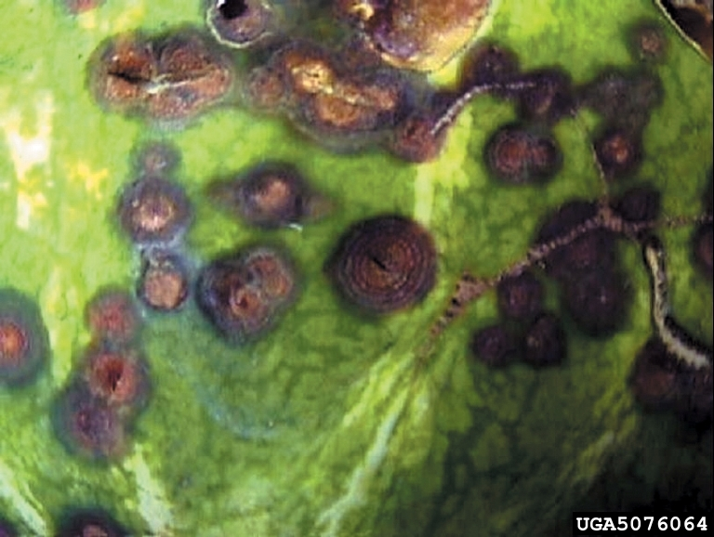
But ZETTA is NOT like that
ZETTA is a broad spectrum pesticide that cover all kind of pest.
ZETTA can kill various kind of fungus, bacteria and virus.
ZETTA will reach the maximum effect once it gets to the certain concentration.

Slide 4
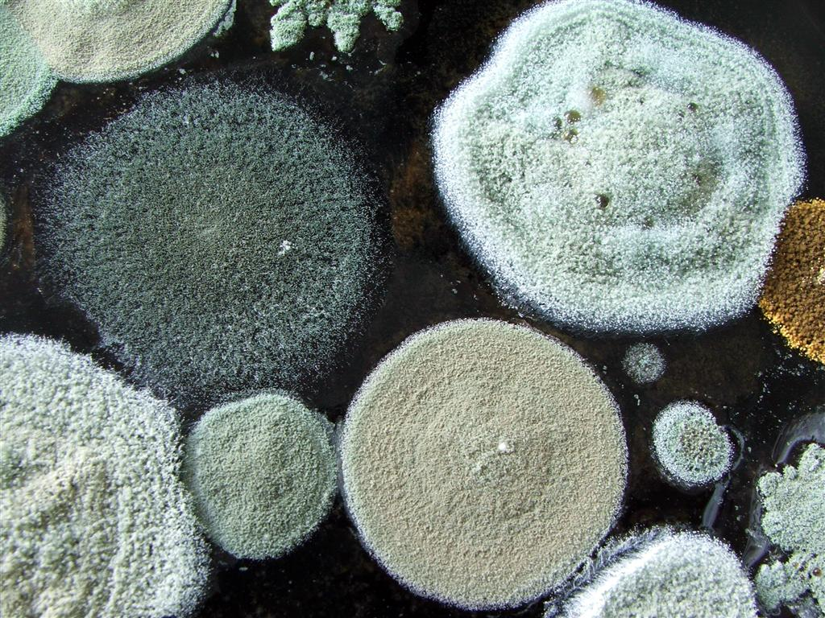
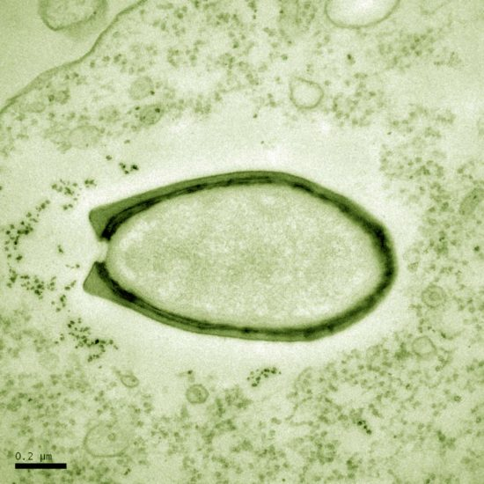
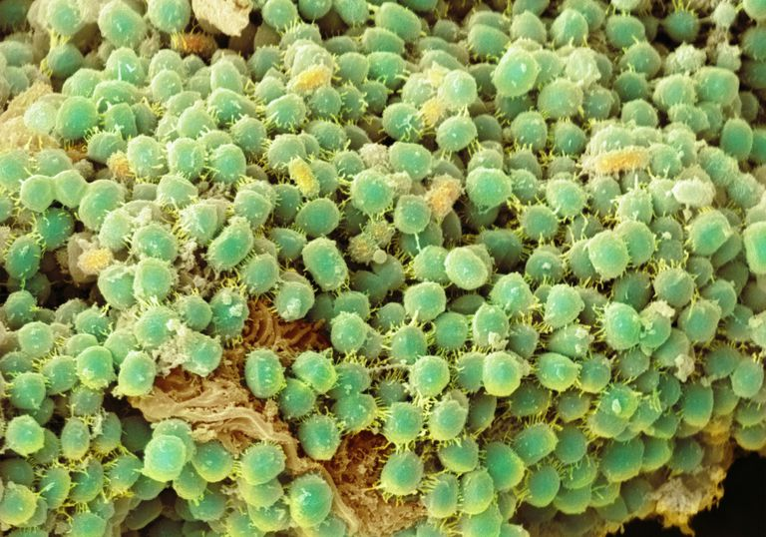

ZETTA contains 2 solutions
N-Alkyl-N-benzyl-N,N-dimethylammonium chloride 12 % w/v
Glutaric 1,5-Pentanedial 10 % w/v
ZETTA can decrease the pest by protein sedimentation ,also kill both gram negative and positive bacteria and spore slowly

Slide 5
ZETTA works with every kind of plants
For preventing : ZETTA 50 CC Soluble in water 100 L / 1 Acre
For healing plants diseases : ZETTA 100 CC Soluble in water 100 L / 1 Acre
For infectious diseases : ZETTA 150 CC Soluble in water 100 L / 1 Acre
*** The volume of ZETTA depends on what kind of plants, density of the area, age, height
and the size and shape of the bush. ***

