Slide 1
Vitamix Control
Organic pesticide that easy to use & Vitamins

Slide 2
What is Vitamix Control ?
3 IN 1 MUTI-PURPOSE SOLUTION : pesticide, disease prevention and vitamins
Preventing plant diseases and pest also save the cost
Activated super fast in both rice and vegetable. For fruits will need more volume of vitamix control because of the bigger size
Vitamix control is organic
Vitamix Control does not effect insect pollinator : bees, butterflies, grasshopper, dragonflies or birds

Slide 3
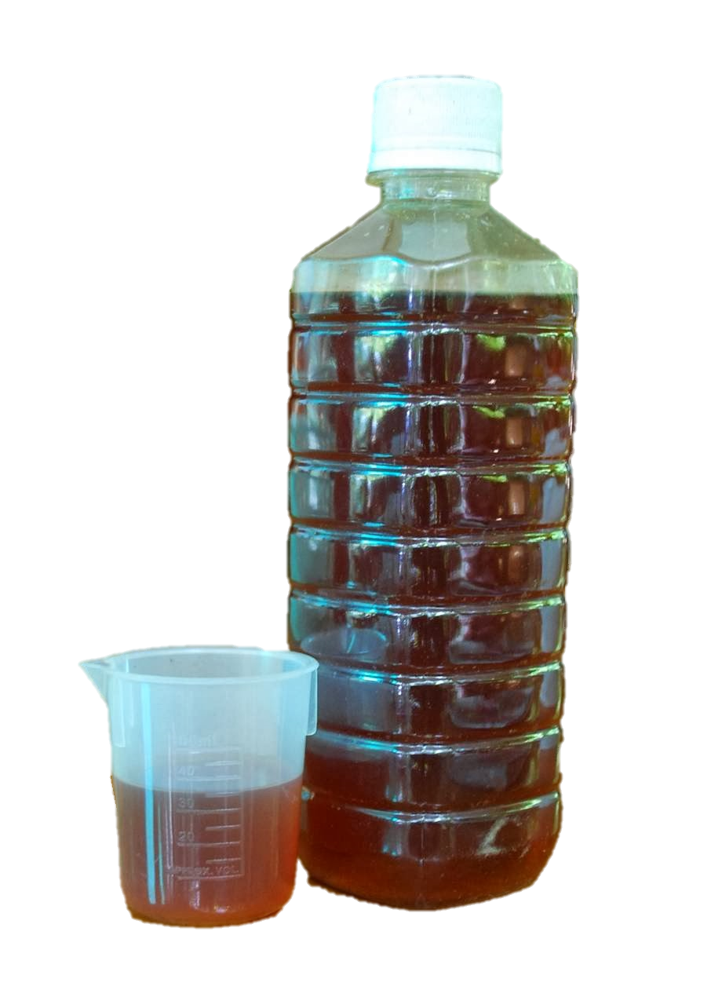
Active IngredIents
Pyroligneous acid
Organic Acids : Acetic acid , citric acid , formic acid
PhenOl
Acetone
Vitamin B6

Slide 4
Ratio and duration
termites control : Vitamix control 1L / water 20L
Mange in animals : VitaMix Control 1L / water 20L spray on animals or wipe them with towel
Plant diseases prevention : Vitamix control 1L soluble in water 200-500L per 4-5 Acre spray every 7-10 days
Pest in the soil : Vitamix control 1L soluble in water 200L per 4 acre
Can use in any age of plants , non-toxic for human or mammals
wood-termites prevention : Vitamix control 1L / water 20L paint it on the woods

