Slide 1
OMEGA
Organic plant nutrient for off season and blossom

Slide 2
Why Omega is important ?
To promote the flowering of the plant and fruit production.
There are products such as Paclobutrazol , Sodium Chlorate , Potassium Chlorate that force the over production of flowers using chemicals that have harmful effects also bad for environment.
Omega is the concentrated carbon group that will change into carbohydrate then glucose in plants which is organic
Omega related to C/N Ratio
Omega increases pollination

Slide 3
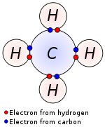
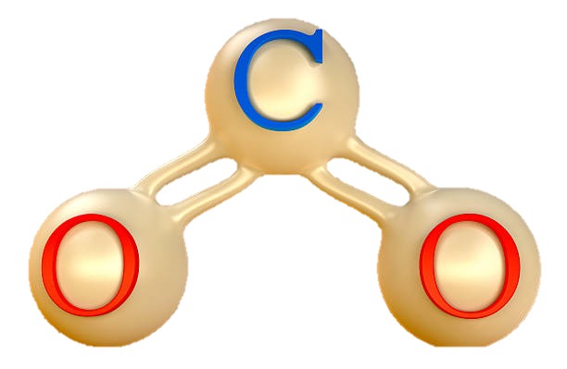
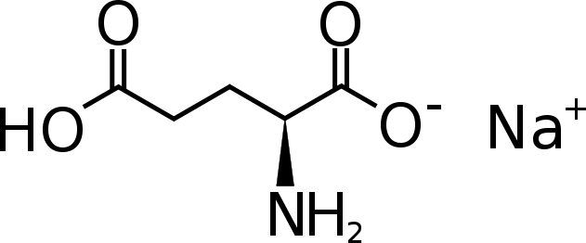
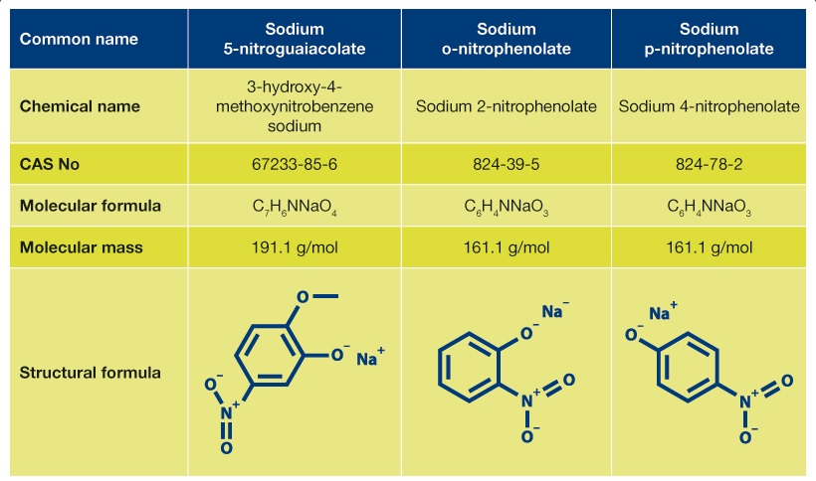
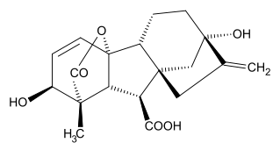
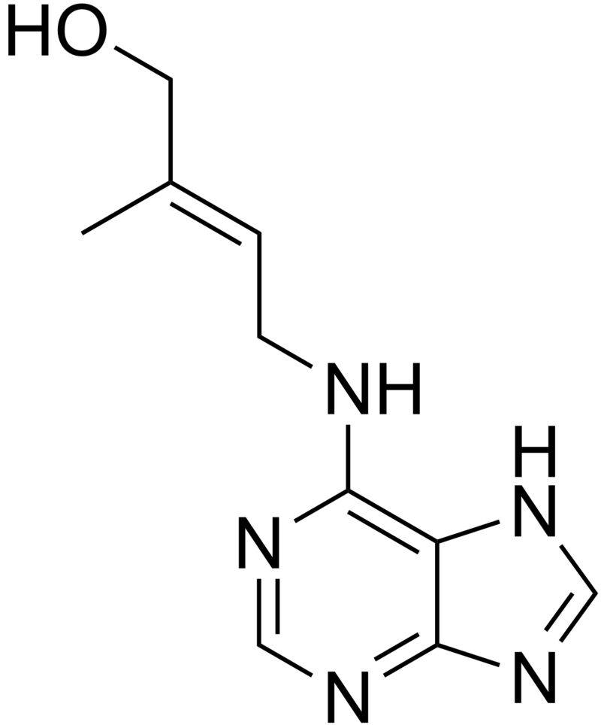
Omega components
Carbon or Carbondioxide
monosodium glutamate
Carbohydrate
GA3
Cytokinin

Slide 4
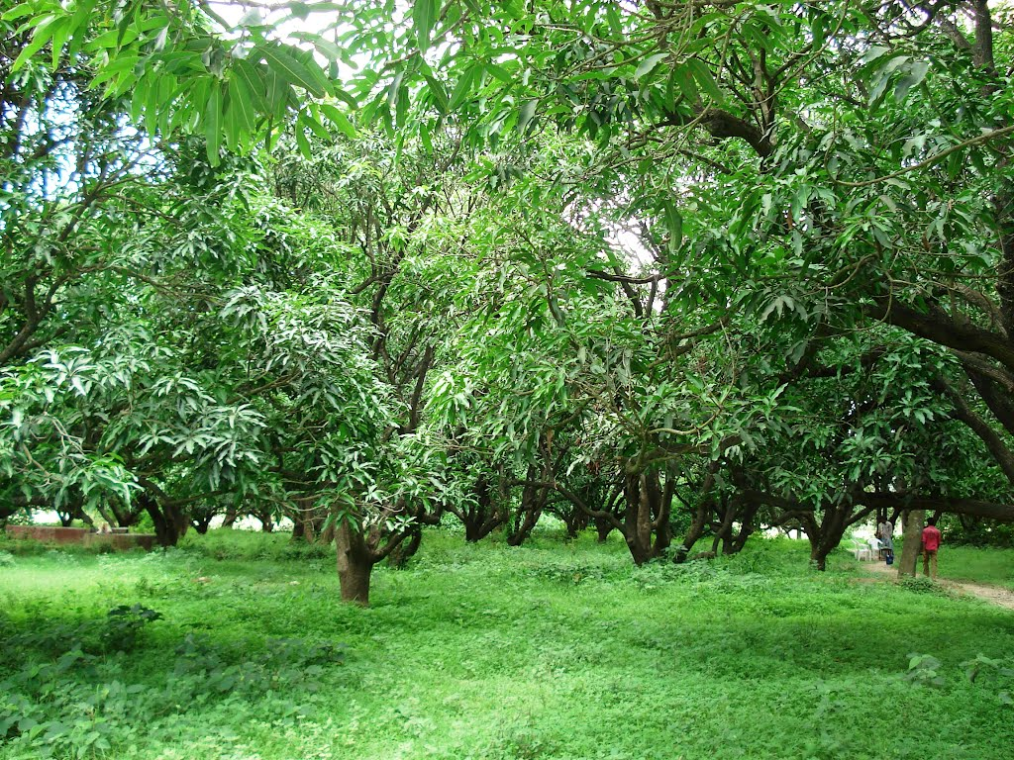
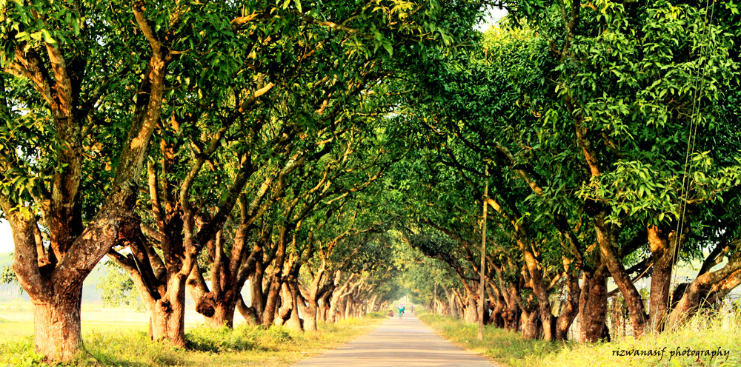
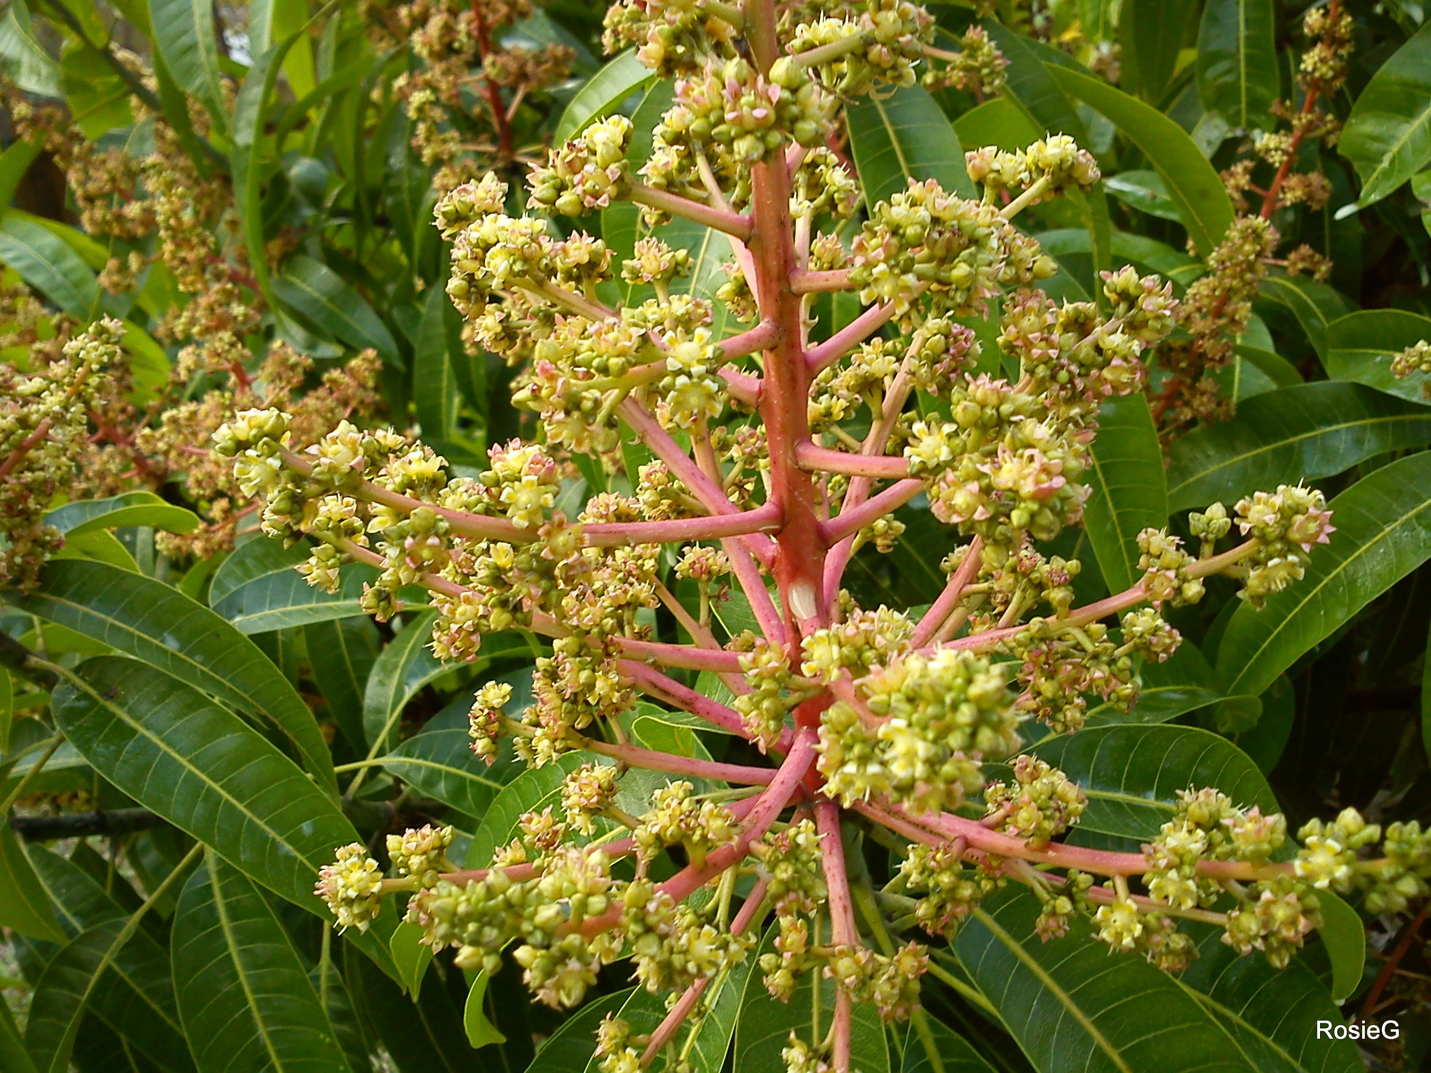
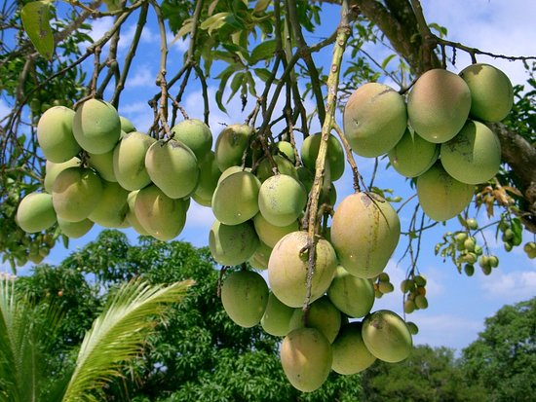
Omega Process
C=Carbon , N=Nitrogen
C/N Ratio
Normal environment
Rainy Season
Lower Rain , High Cold
Dry Season
February - April
May - August
September-November
December - January

Slide 5
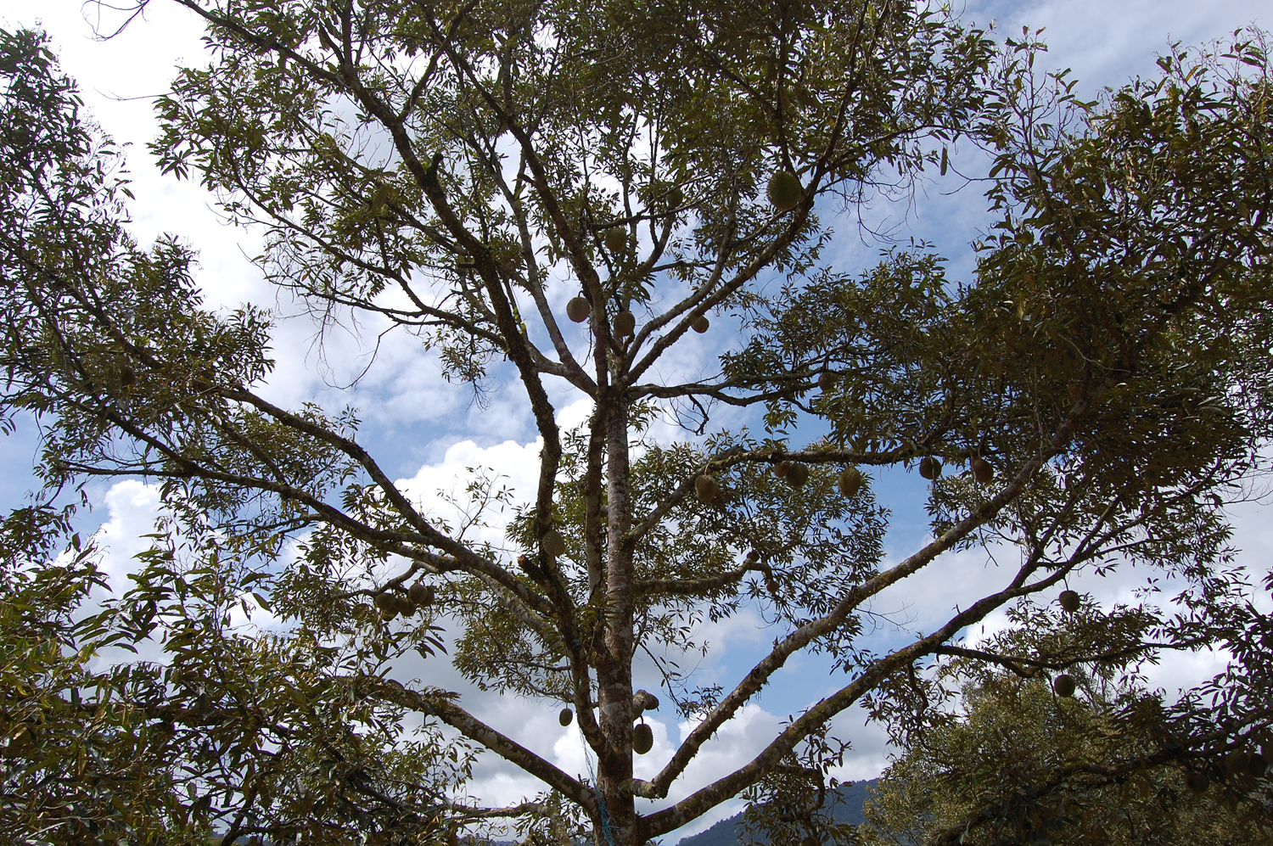
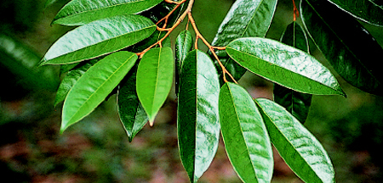
Mechanism and Condition
Decrease the amount of Nitrogen as much as possible
Accumulate carbohydrate in braches as much as possible
Pruning is the key
the bigger branches, the better
All leaves are ripe enough for flowering

Slide 6

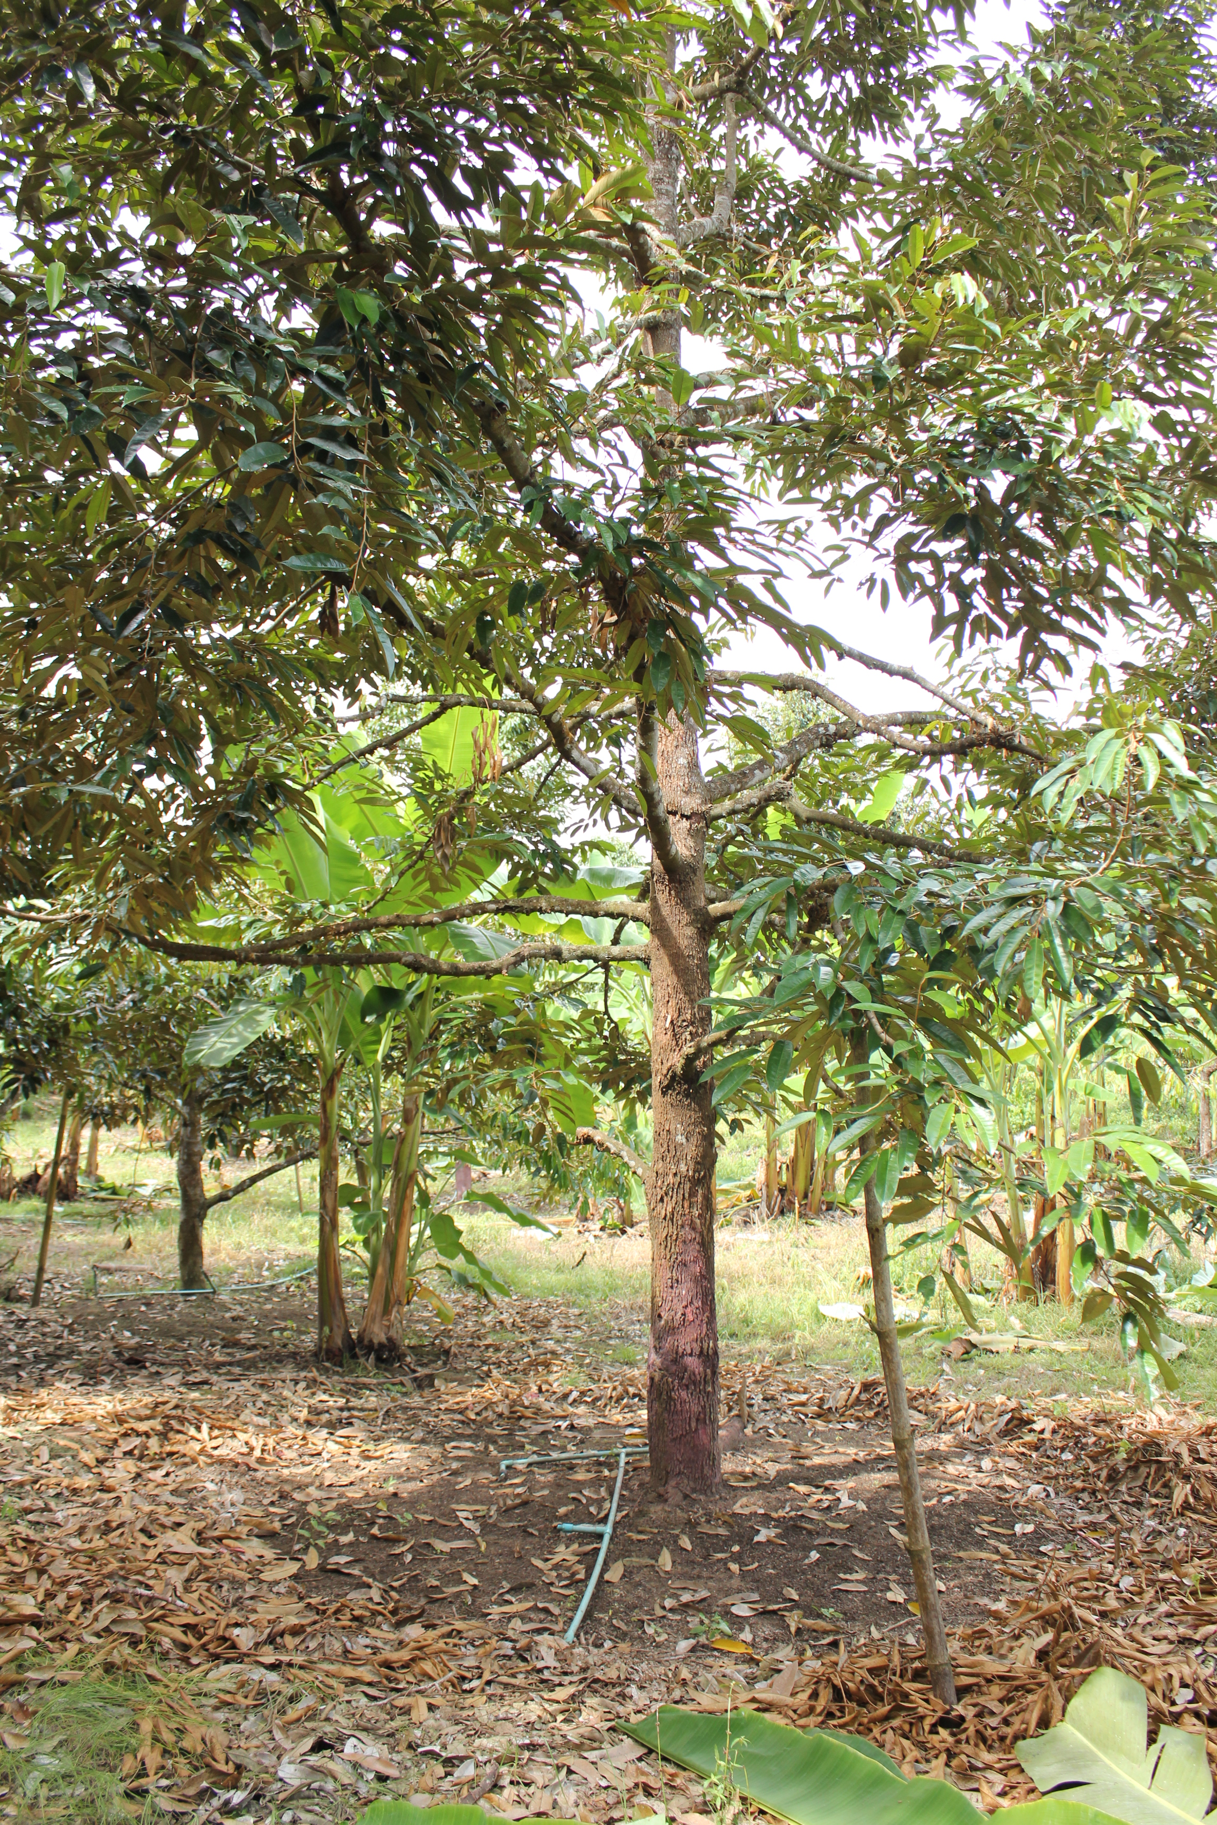
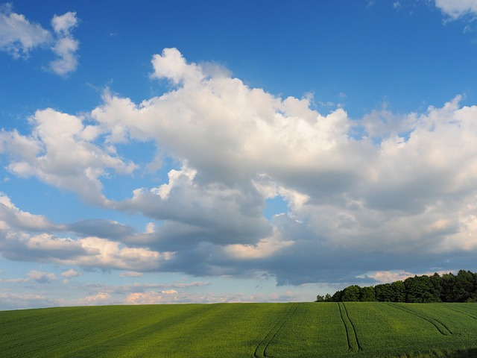
Conditions that promote the flowering
Cold weather
The most important thing is plants need to be dry. No watering for 15-21 days
Longer day time

Slide 7
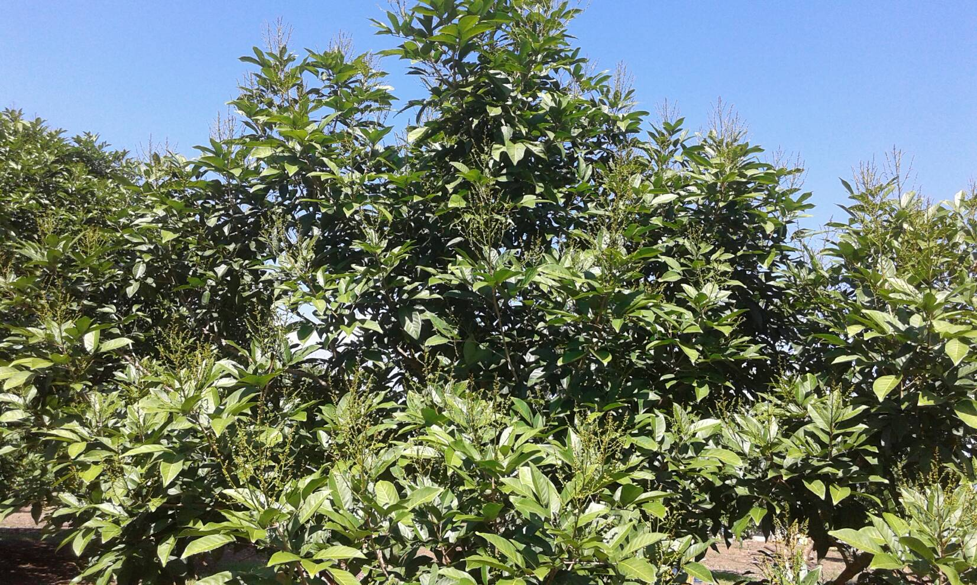
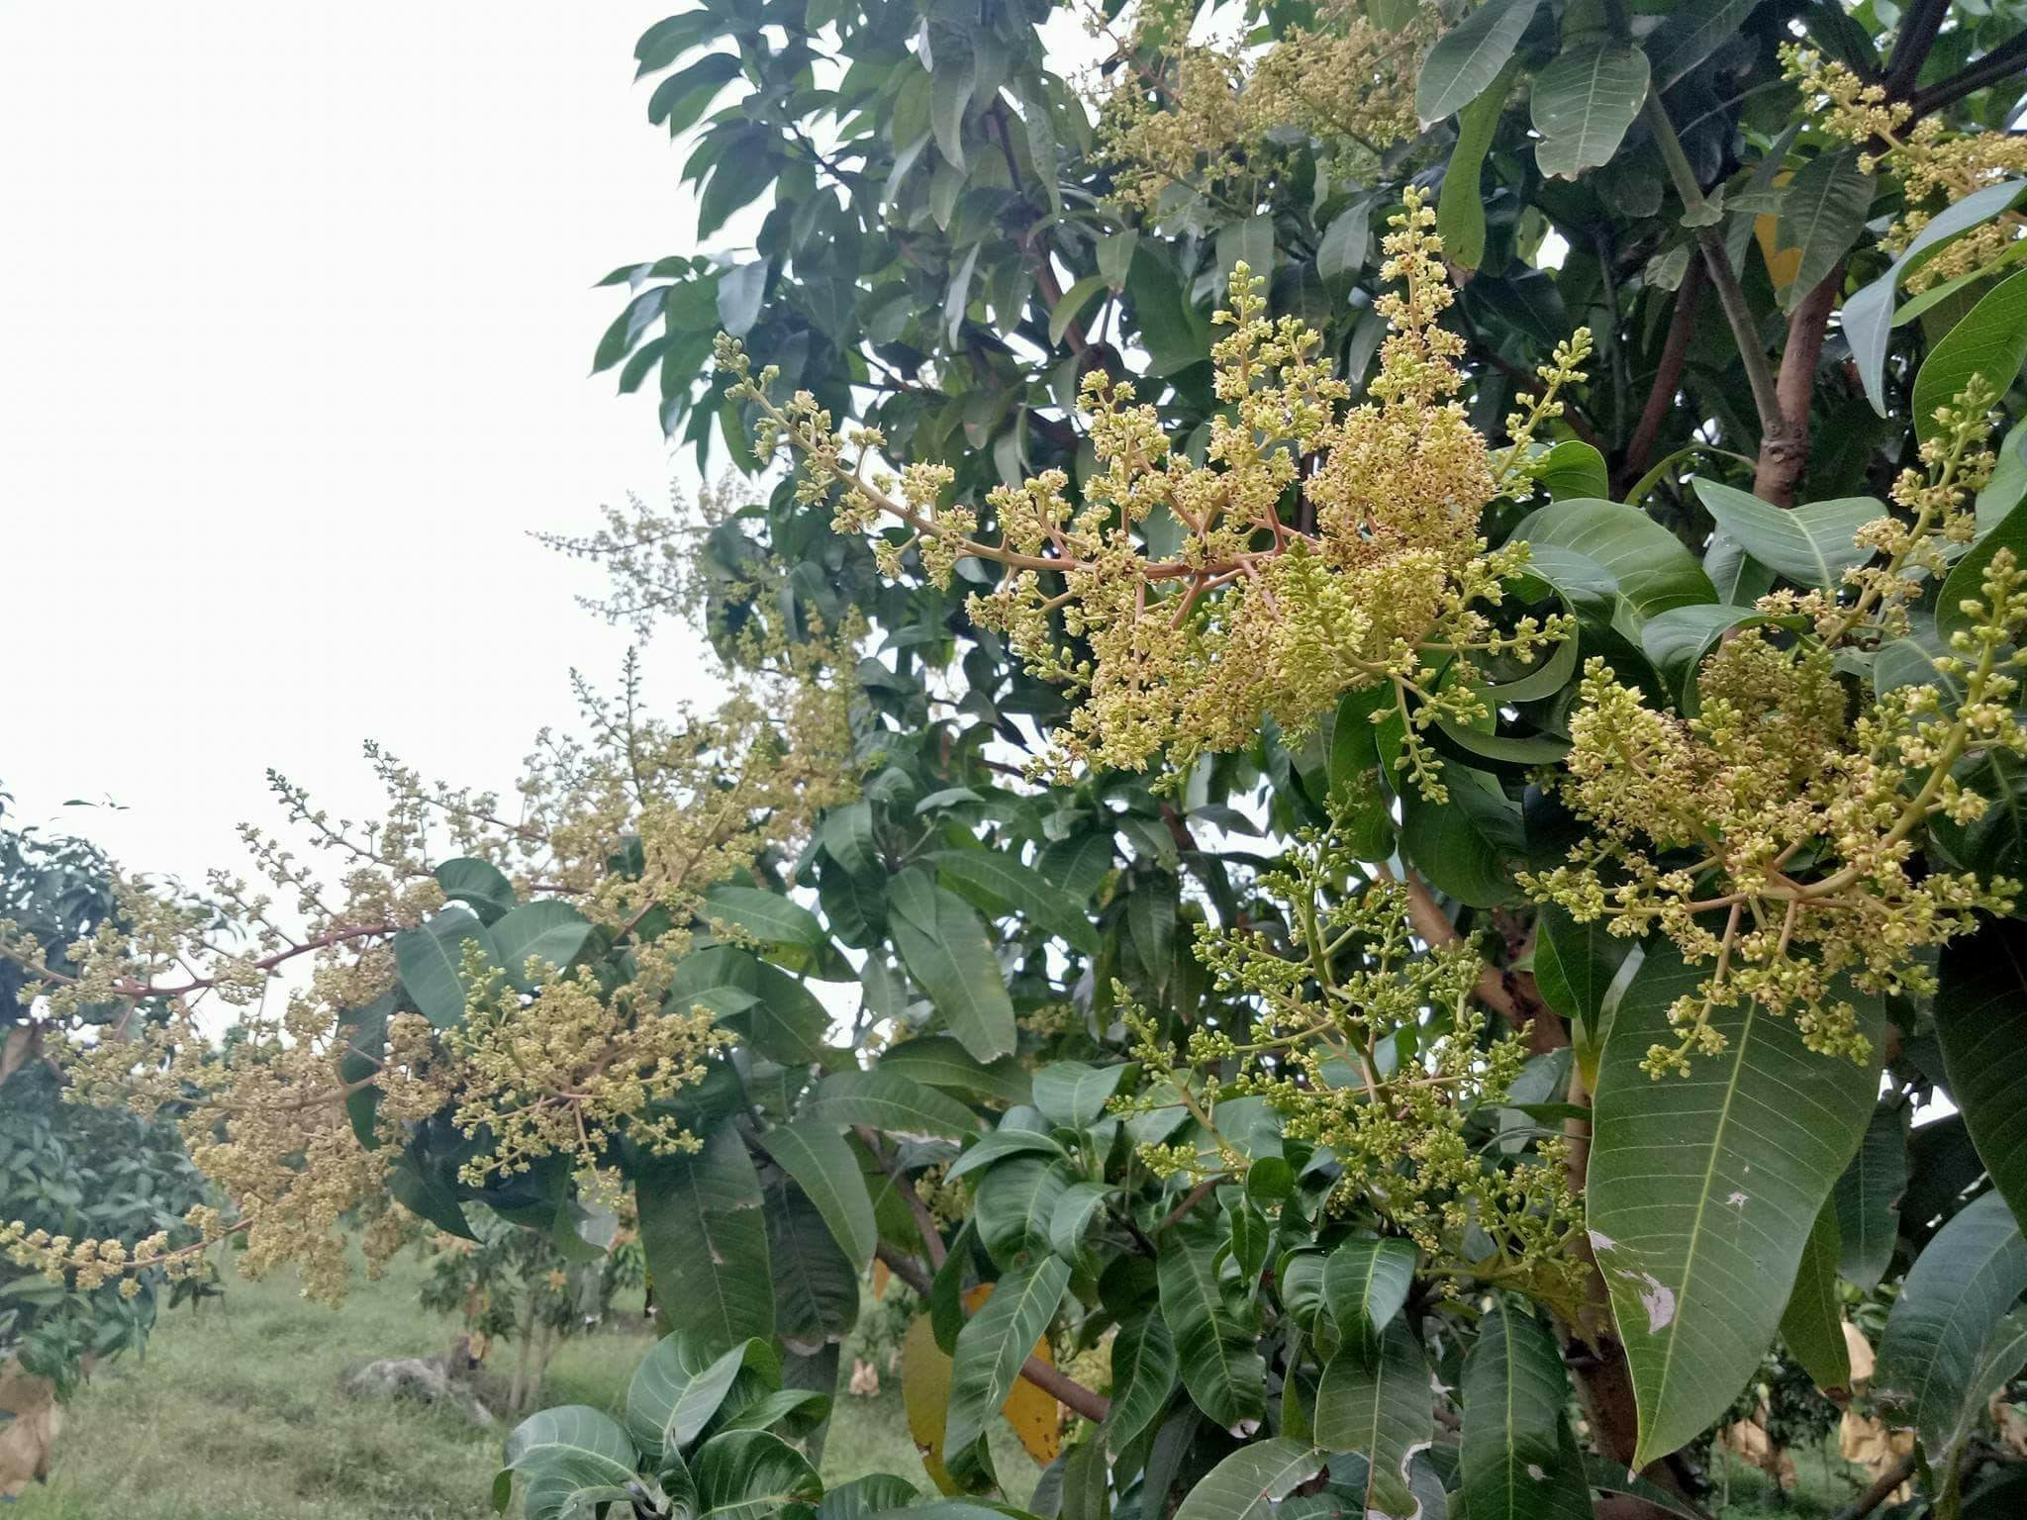
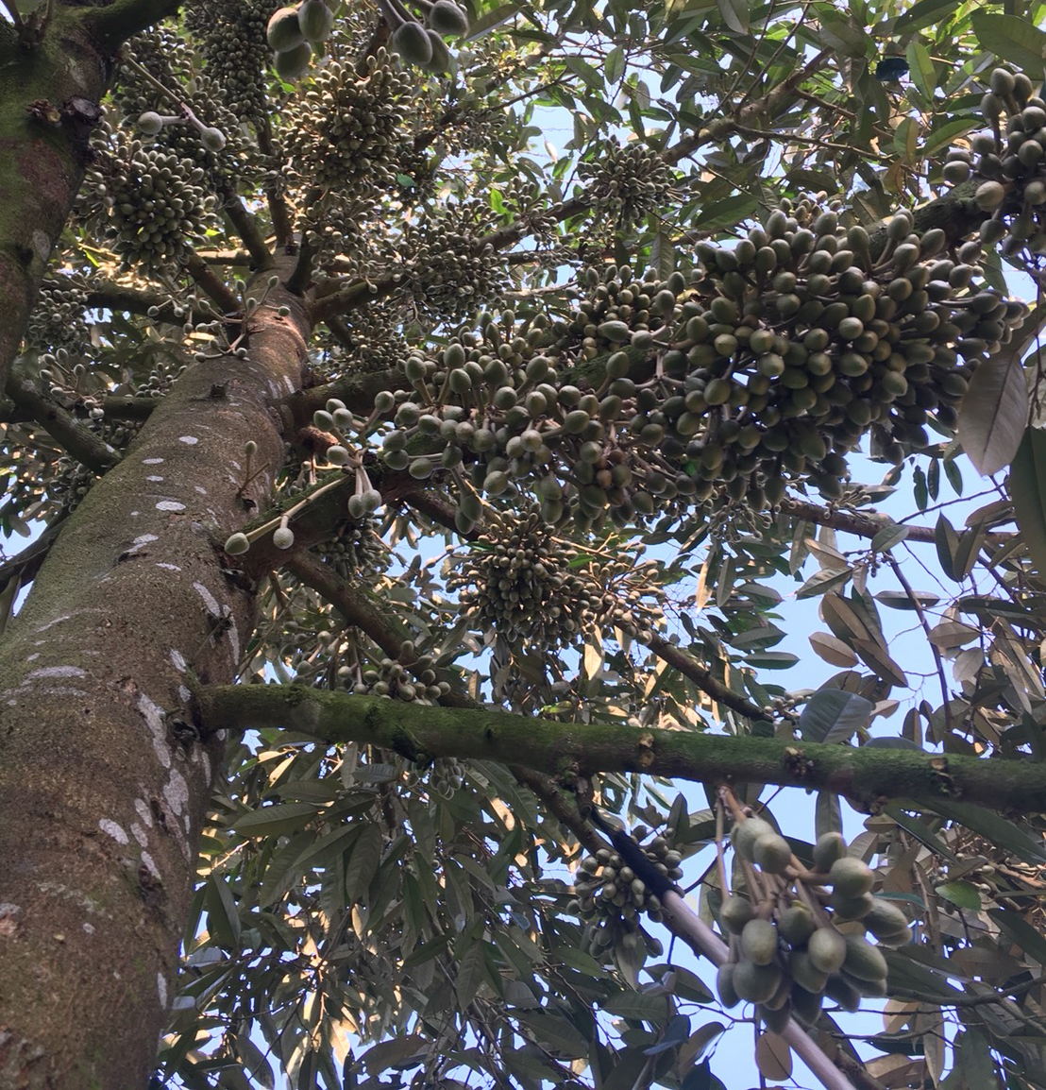
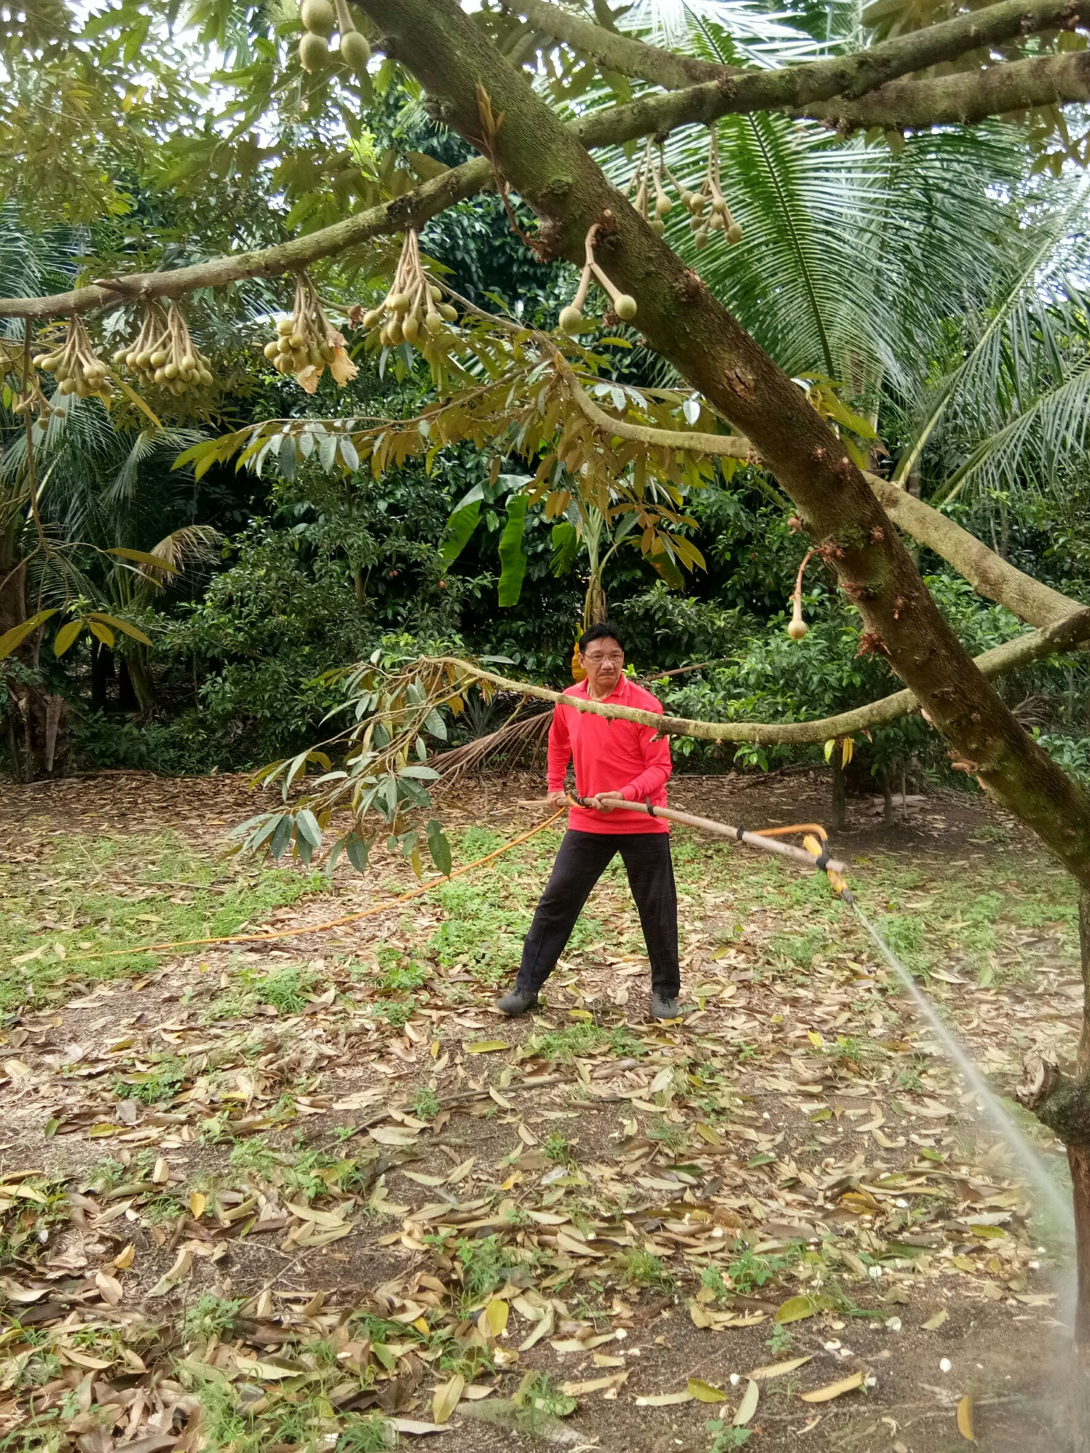
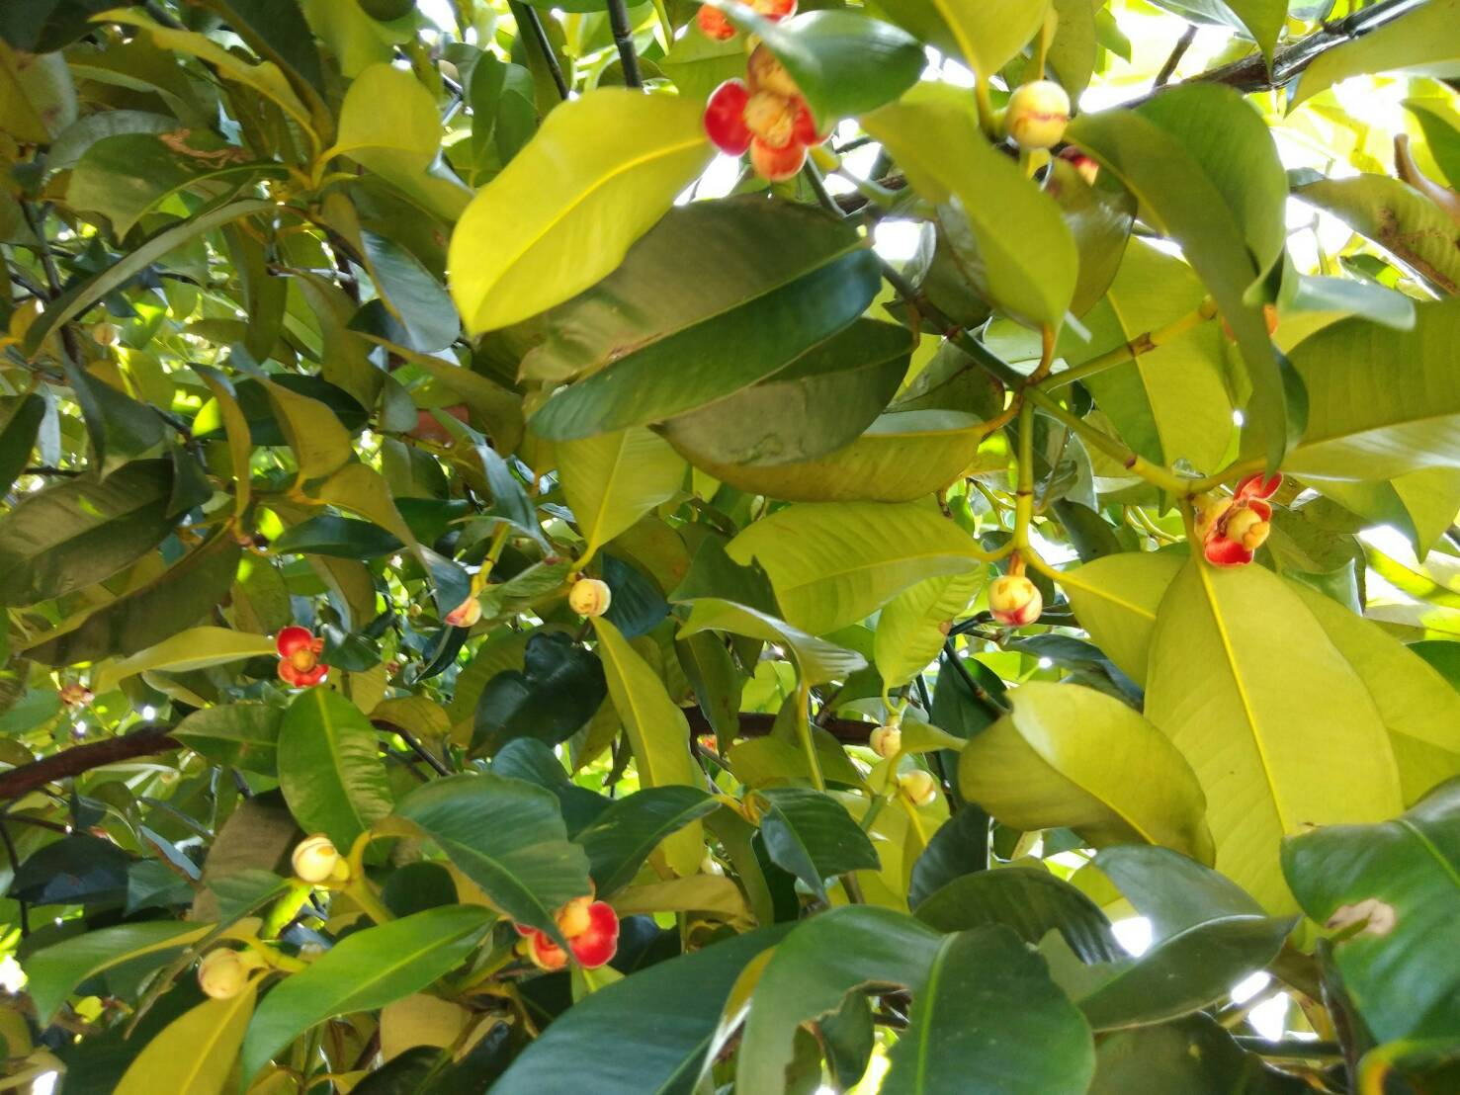
After flowering Omega helps
Flowers bloom longer
Help reproduction
Help changing the flowers into the healthy fruits
Farmer should spray Omega on the soil to make the plants bloom and reproductive

Slide 8
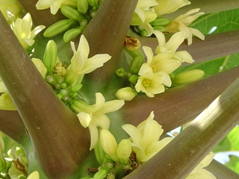
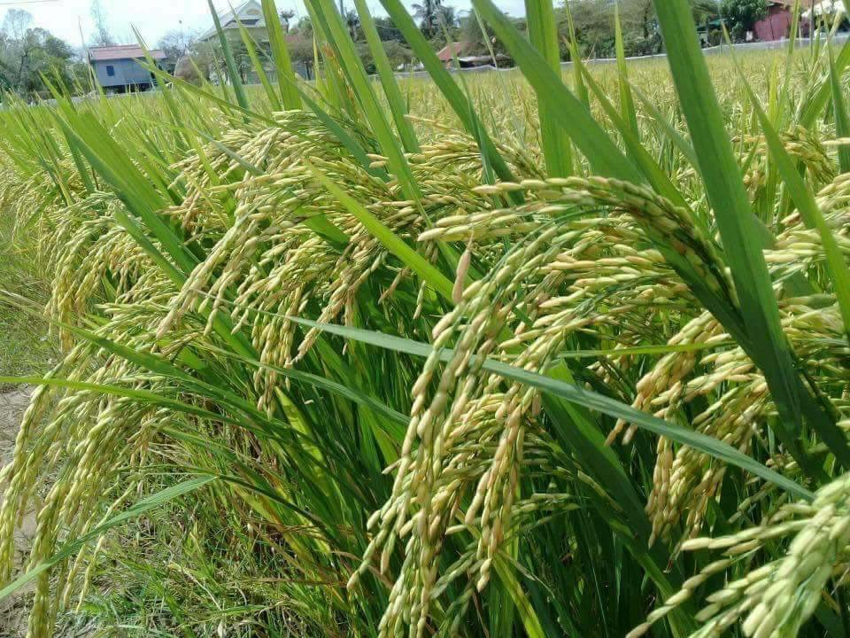
Why Omega promotes reproduction?
Omega contains plant hormones
These hormones will help pollination by turn stamen into pistil
Also the smell luring the insect pollinator
In fruits, stamen and pistil are in different flowers so the reproduction happen slowly. Using too much chemicals will decrease pistil so the reproduction will be delayed. Organic Omega will help the plants reproductive faster.
In corps, pollination happens easily because the stamen and pistil are near each other and in the good ratio.

Slide 9
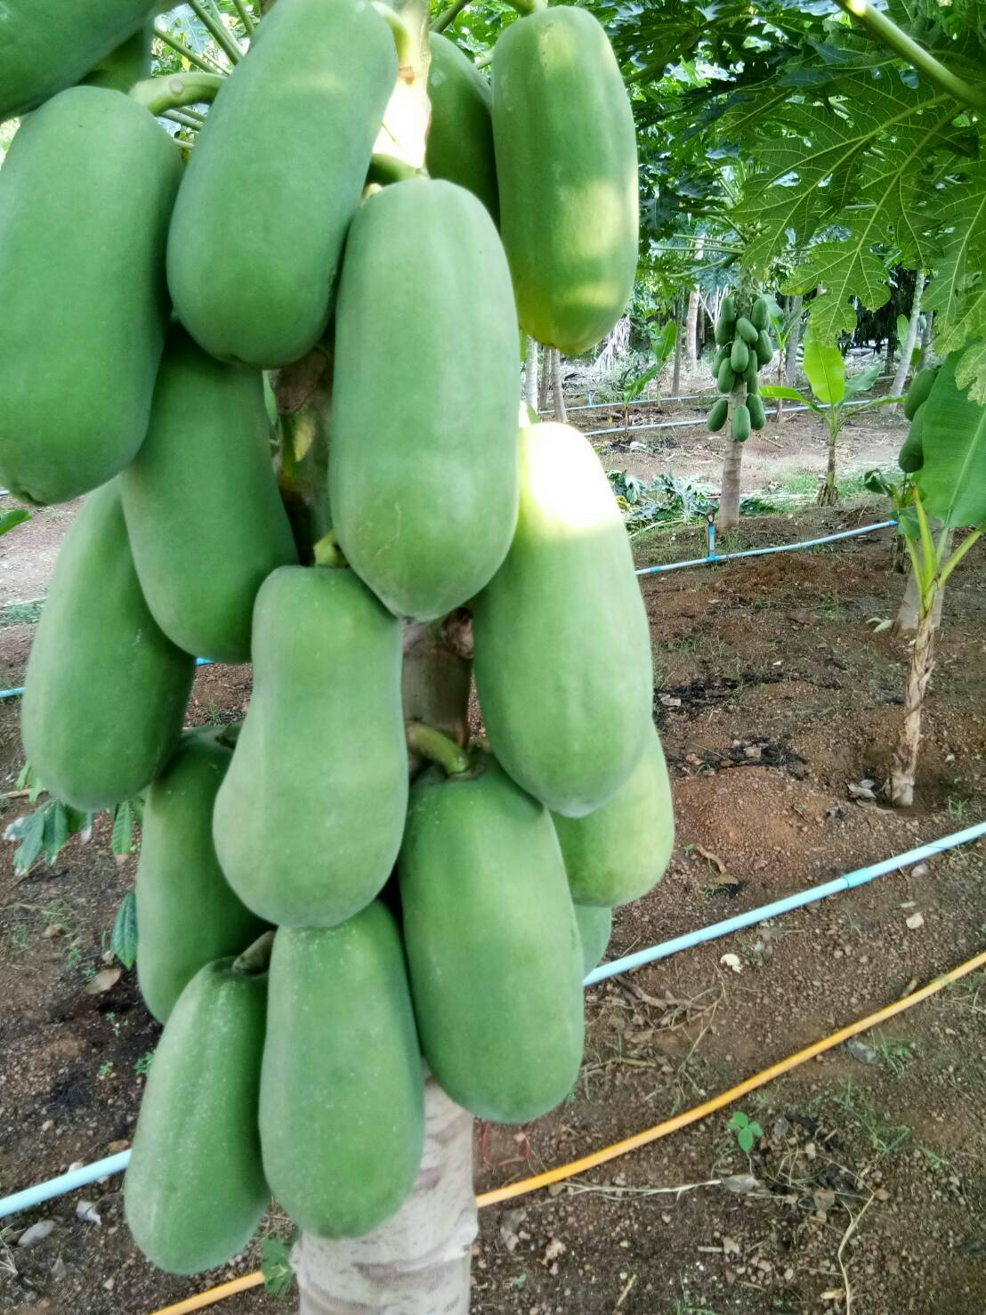
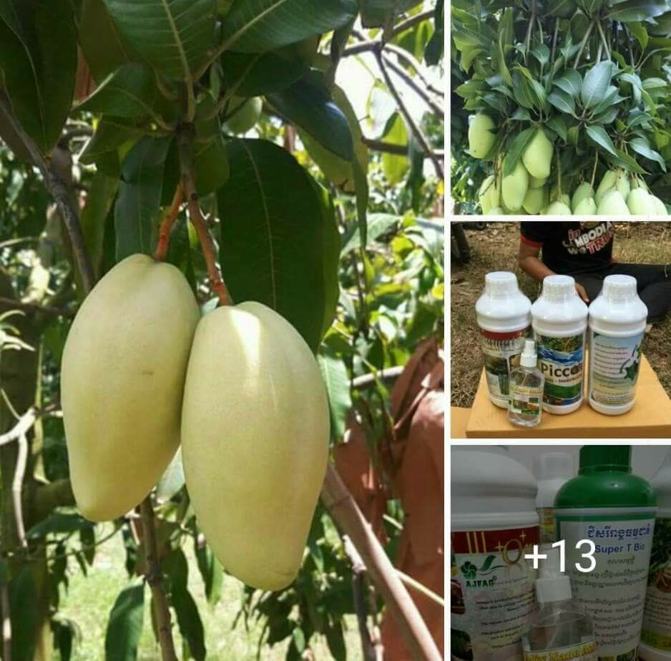
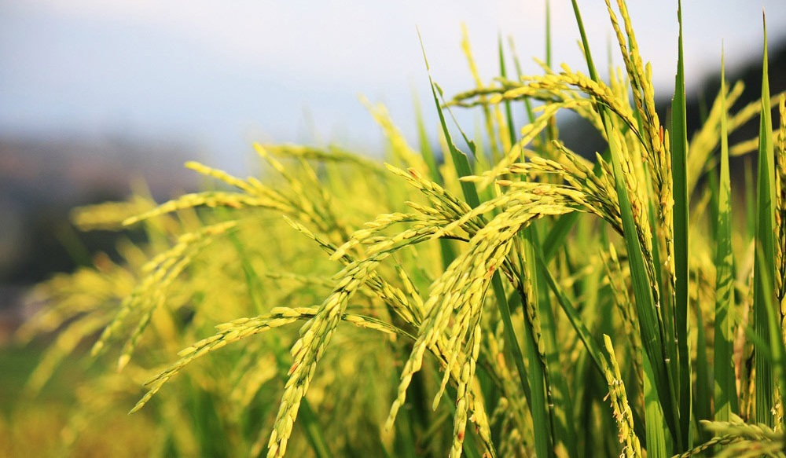
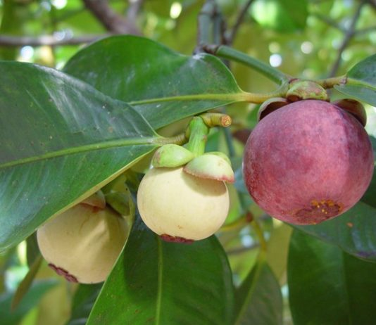
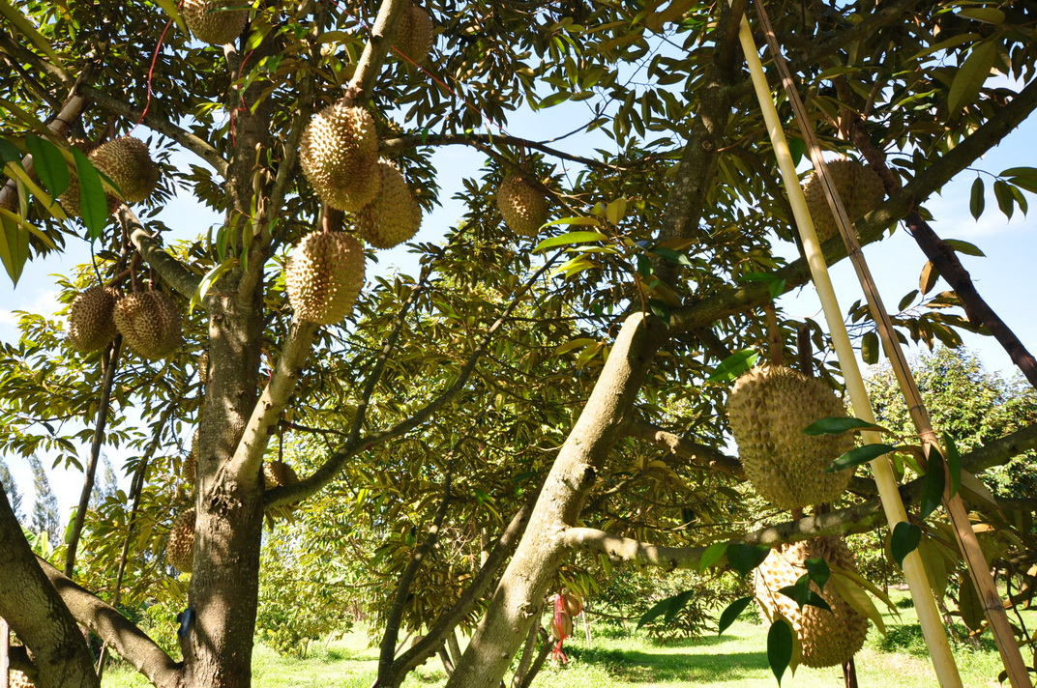
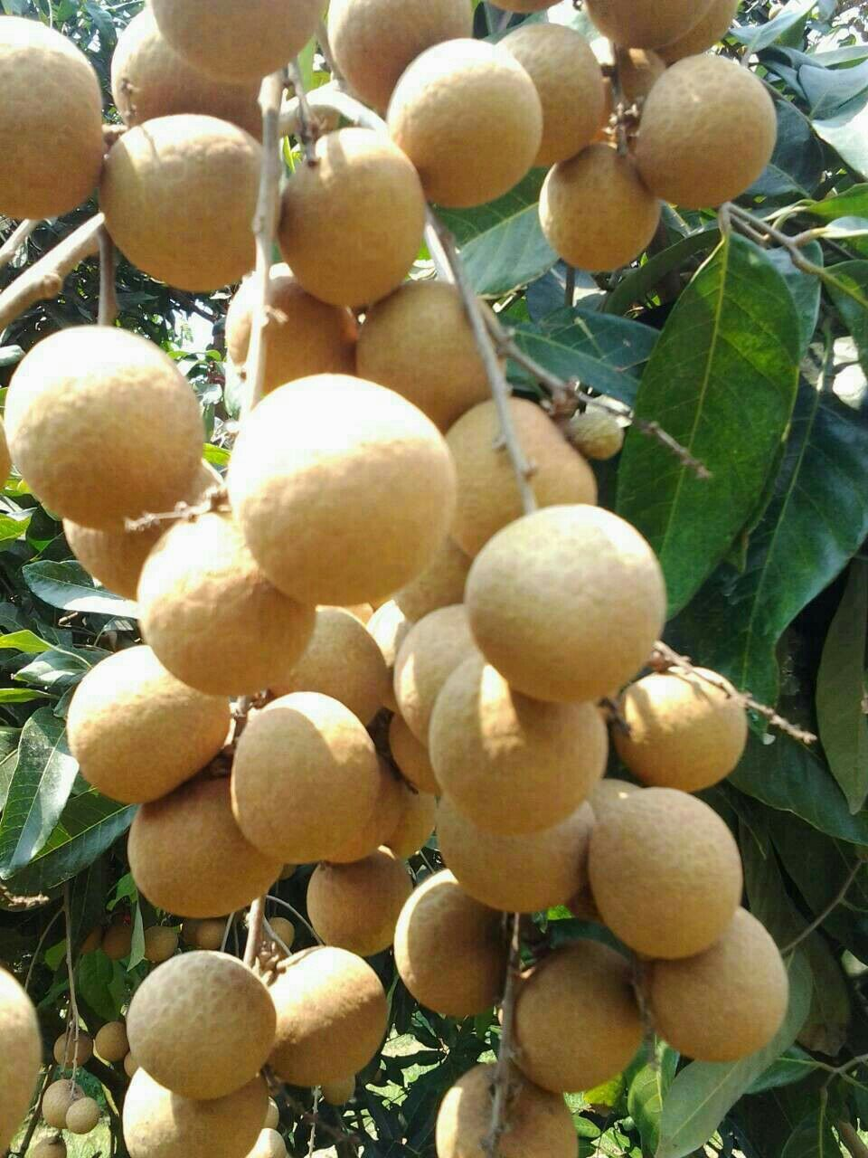
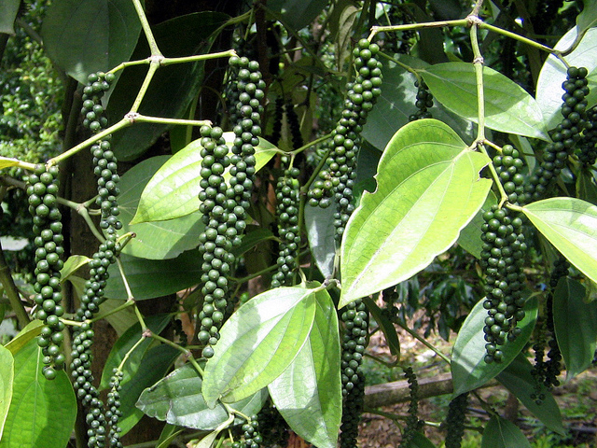
Omega
Omega can use with any kind of fruits
Omega is organic and non-toxic
Omega helps increase the size ,the pulp and the weight
Omega is cheap compare to the effectiveness

Slide 10
Ratio and Duration
1 L per 1000 L of water
200 ml per 200 L of water
20 ml per 20 L of water
Spray the plants before it flowers twice.
Spray the plants to promote flowering
Spray the plants to maintain the flowers
Spray during the fruit stage to make the fruit healthy
The good method is to spray it all over the plants and also on the branches where it blooms.

