Slide 1
Super Chitosan
Organic Nitrogen Fertilizer

Slide 2
Super Chitosan is Chitosan from Japan made of cuttlebones and shrimp shells
Not a lot of organic substances can give an special result like Chitosan. Chitosan gives Nitrogen nutrition which is an organic nitrogen.
Chitosan also provides sodium which is related to the changing nitrogen into amino acid and also many reactions in plants
Chitosan gives carbohydrate to plants. Carbohydrate will make the plants more fresh, strong and can absorb more nutrition.
Chitosan is dissolved by lactic acid and acetic acid which have mild antiseptic activity.

Slide 3

Super Chitosan composed of
Linear Polysaccharide composed of randomly
Distributed β-(1->4)-linked D-Glucosamine
and N-Acetyl-D-glucosamine
Chitosan is linked polymer that connected together by acetyl group. Chitin will change into Chitosan when acetyl groups are cut, so chitosan can liberate from the polymer chain then plants can absorb it.

Slide 4
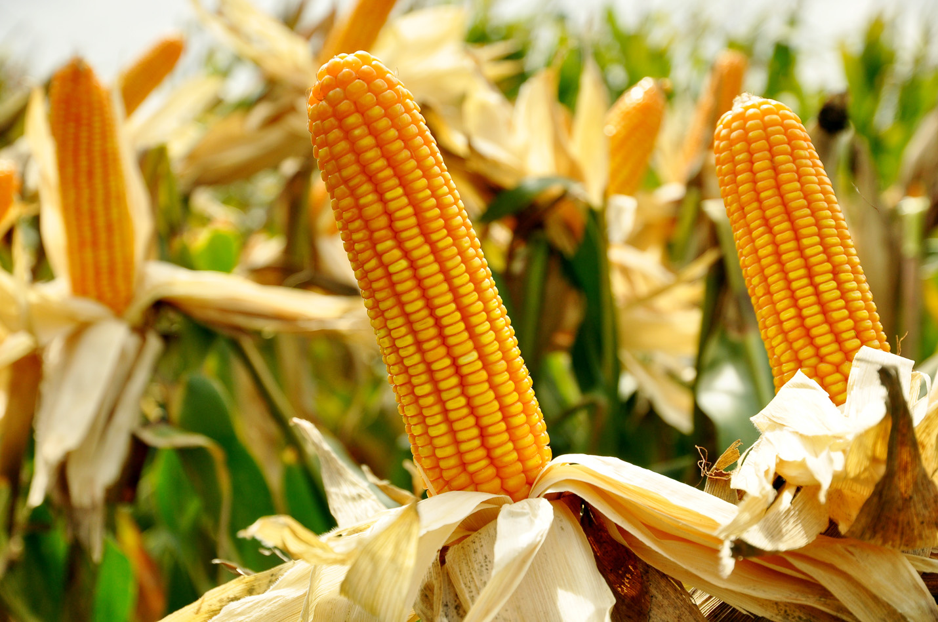
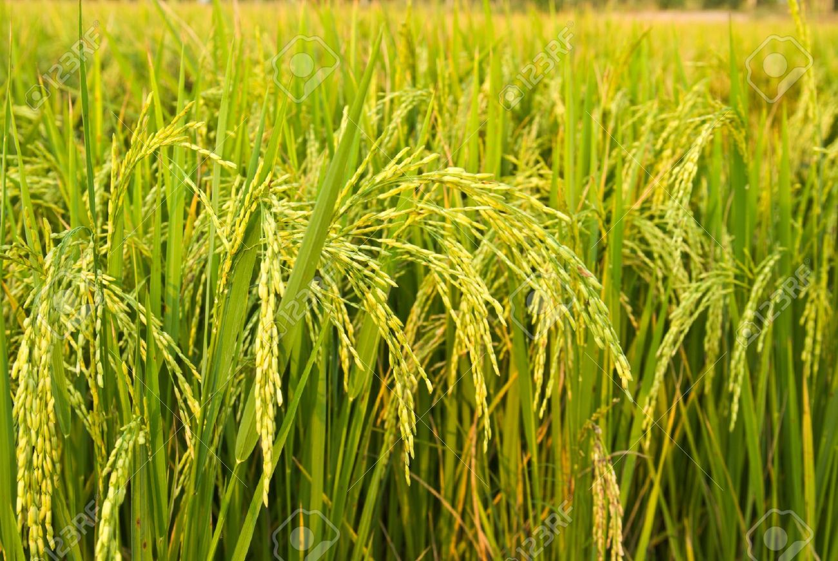
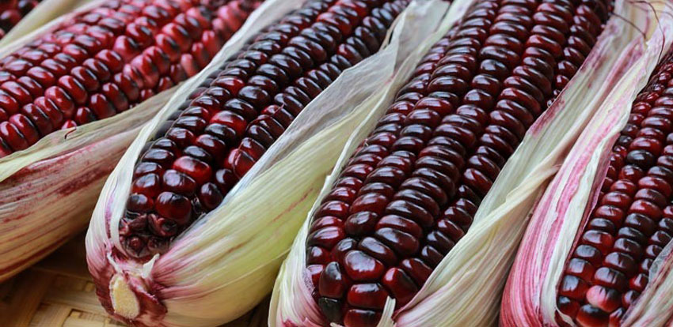
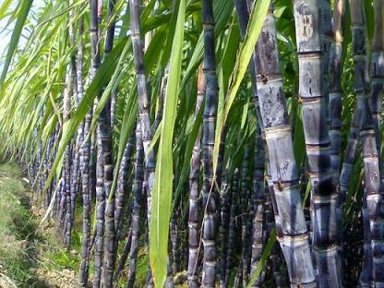
Why Super Chitosan ?
In hot weather, plants go dry and sere. Spraying Super Chitosan will be a booster give them more energy and help refreshing.
When you need to grow more leaves or put forth fresh leaves or more branches.
When you want plant accumulate more nutrition. If you use it with amino acid, it will increase developing of leaves, branches and stems.
Spraying Super Chitosan on the soil will help roots absorbing and finding nutrition
Using Super Chitosan will decrease transpiration leads to slow the sere process. Chito-Max
Super Chitosan contains organic nitrogen
Using Super Chitosan together with other supplements will help the plants grow super fast.

Slide 5
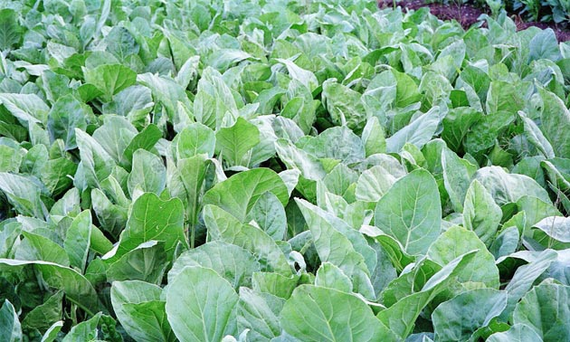
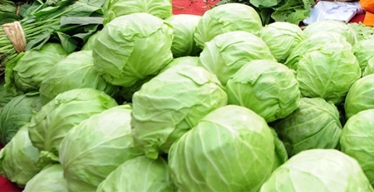
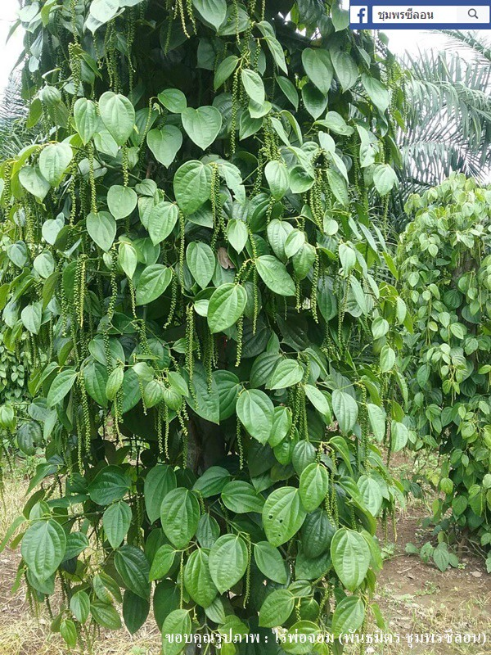
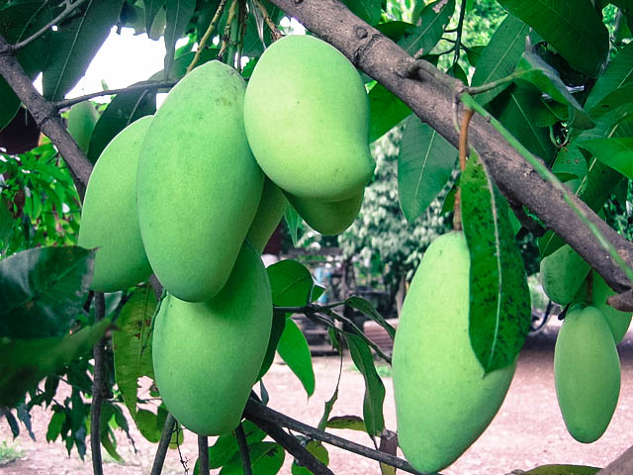
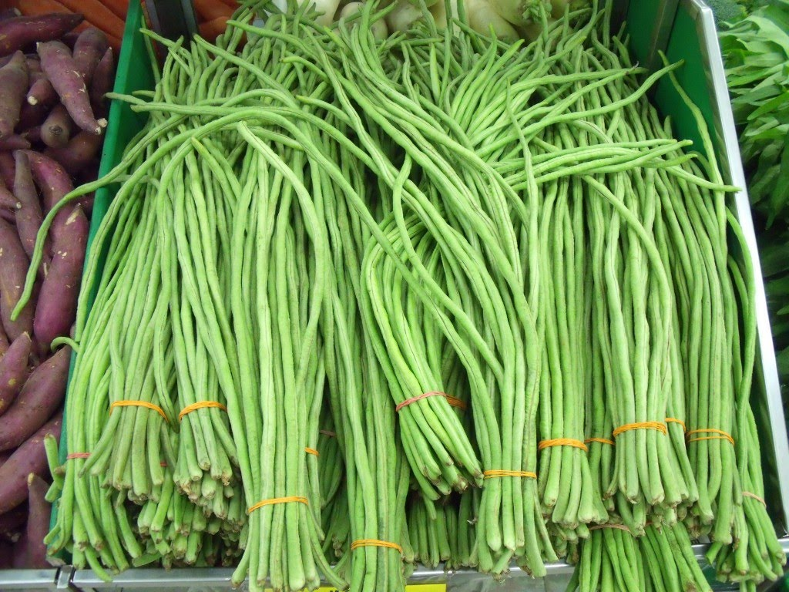
Super Chitosan ratio and duration
Super Chitosan works best in the morning which is the time for Photosynthesis
Super Chitosan can spray in any ages of plants
the rate and ratio are 150 cc Soluble in water 100 Liter / 1 Acre

