Slide 1
TERA
Organic Major Fertilizer + Hormone + Vitamins

Slide 2
What is TERA ?
Use imported amino acids from France.
Amino acids will increase the growth of leaves, flowers, branches, stems
also vascular tissue system.
TERA is plant supplements or organic liquid fertilizer that can be used
instead of normal fertilizers.
TERA is concentrated organic amino acids that plants can absorb easily
and no toxic residue.
TERA is an amazing plant food that can use at any age with any kind of plants.
Using Proti-Max routinely will make plants strong and heathy .

Slide 3
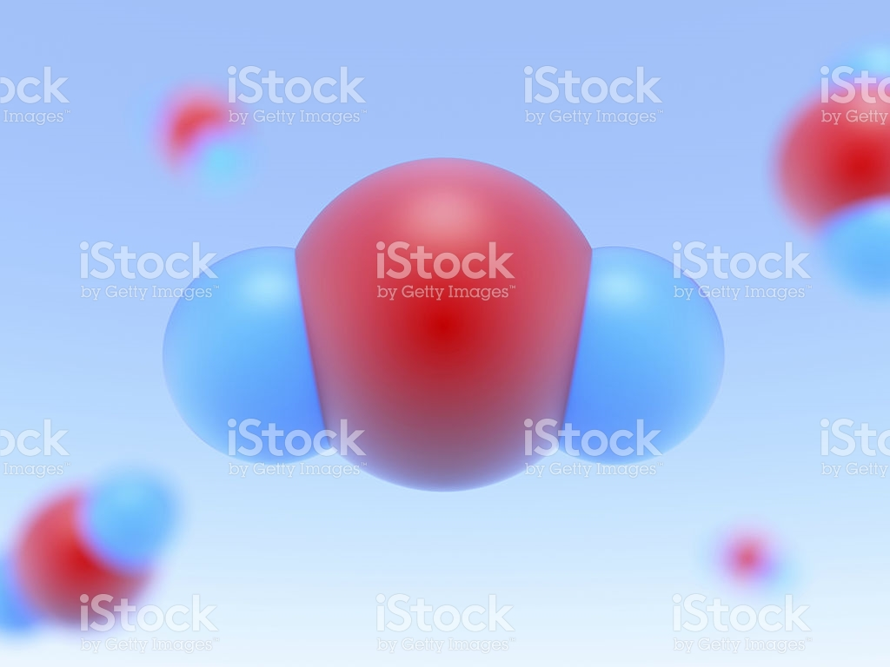
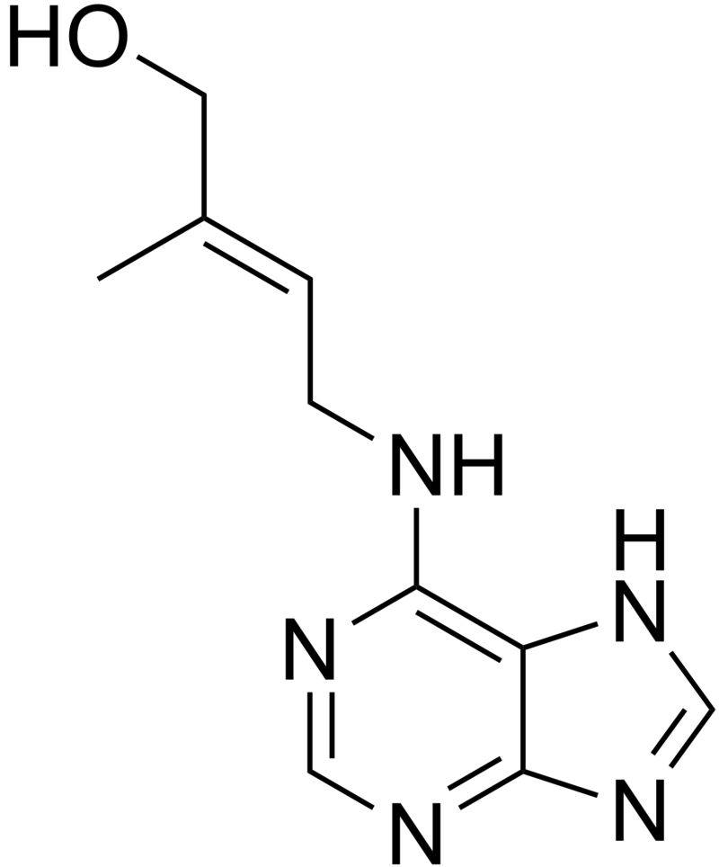
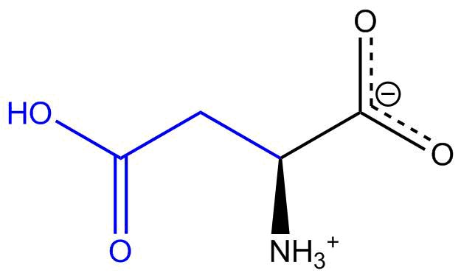
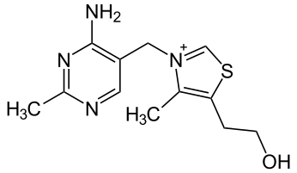
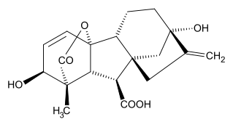
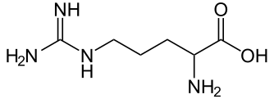
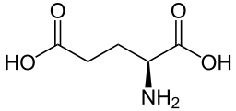

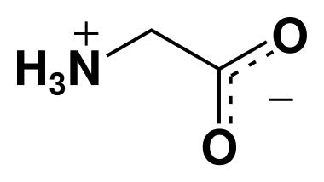
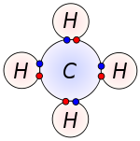
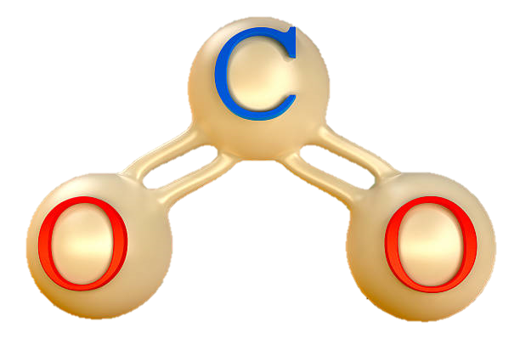
TERA components
Thiamine Mononitrate
Arginine
GA3
Cytokinin
Aspartic Acid
Glutamic Acid
Glycine
Phenylalanine
TERA contains 17 amino acids such as Alanine, Arginine, Aspartic Acid, Glycine, Histidine and Glutamic Acid
TERA also contains Carbon Compound, Organic Hormones such as Giberrellin, Cytokinin.
TERA also has Vitamin B1

Slide 4
Why TERA ?
Changing chemical substances into plant’s food takes many steps and energy such as
  Uria : use Uriase enzyme to change uria into ammonia then ammonia into amino acids
  Nitrate reduction : 2 steps which are
  - nitrate reductase enzyme cut nitrate into small molecules inside cytoplasm in mesophyll
  - nitrite will move into chloroplast then cut into smaller molecules by Nitrogen reductase then move to chloroplast for turning into amino acids later.
These process are slow and difficult. Bad weather condition or plant disease will delay these steps. And reduce plant growth.
Spraying organic substance to the plant will give dissolved amino acids straight to the plants so using Proti-Max can increase the growth significantly.
Using TERA will decrease the use of Nitrogen , Sulfur , Calcium , Copper , Zinc , Ferrous fertilizers . So it will save the cost.
plants need a lot of energy to use in amino acid synthesis , so giving the TERA will increase the amount of amino acid and save the plant’s energy to use for something else such as recovering from the disease.

Slide 5
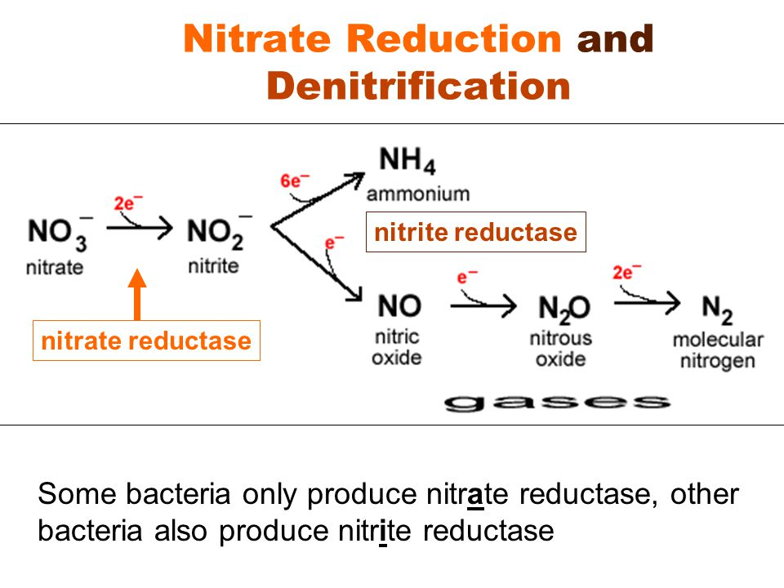
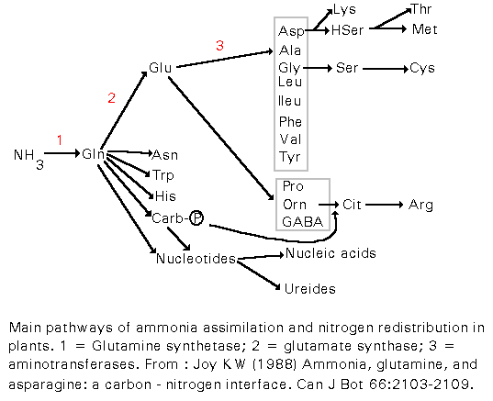
Example

Slide 6
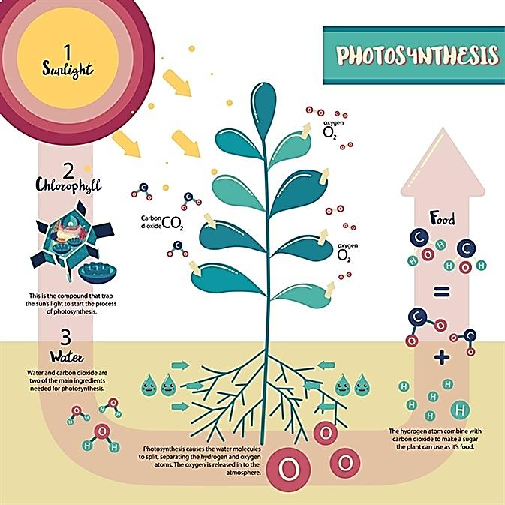
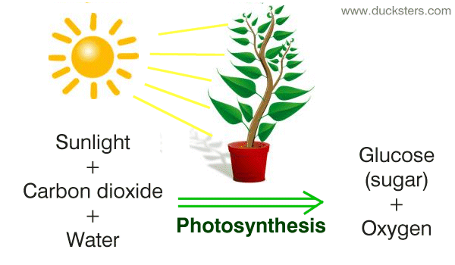
Plant’s Food

Slide 7
TERA gives Nitrogen and Carbon in organic form as well as other nutrition
TERA gives Nitrogen in the form of Amino Acids
TERA gives Carbohydrate in the form of Carbon which is the main substrates

Slide 8
Amino Acids Benefits
Proline
Relief the stress from drought , heat and alkaline soil
Decrease cell dehydration and help controlling the stomas
Alanine & Glycine
For chlorophyll synthesis
Increase the immune for virus
Glutamic acid (amino acids precursor)
For amino synthesis
increase polyamines which is about plant stress
Arginine
Growth controller
Developing the roots
control pectin production inside cell walls makes the tissue intact
plant hormones precursor, increase ethylene help the leaves growth
increase polyamine which is about plants stress from alkaline or acidic soil.
Methionine
plant hormones precursor
increase ethylene and cytokinins
For Oxin movement
Developing the roots and cell division
Aspartic acid & Phenylalanine
Increase root growth

Slide 9
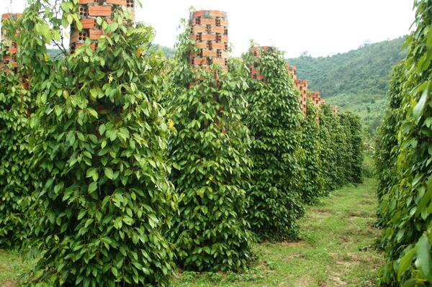
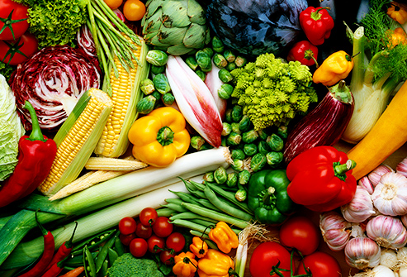
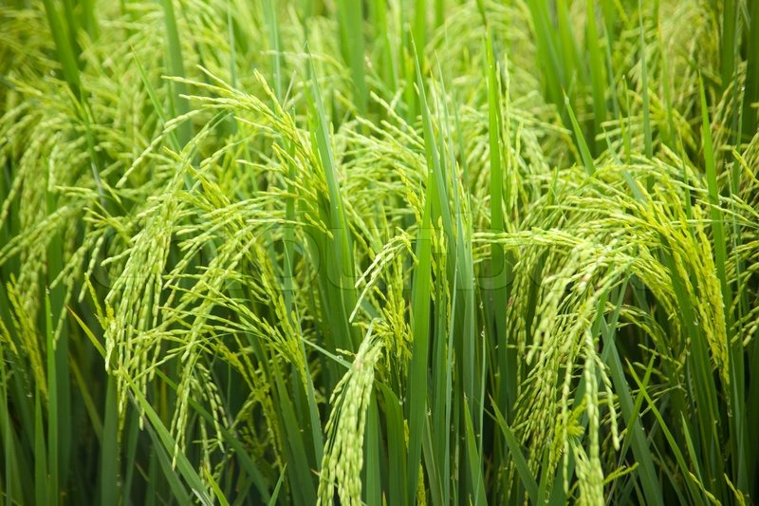
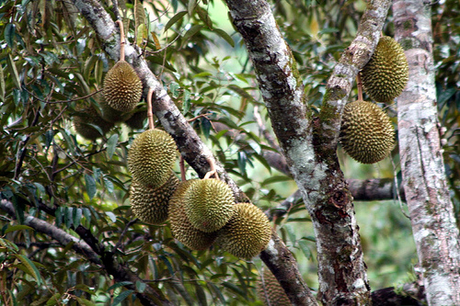
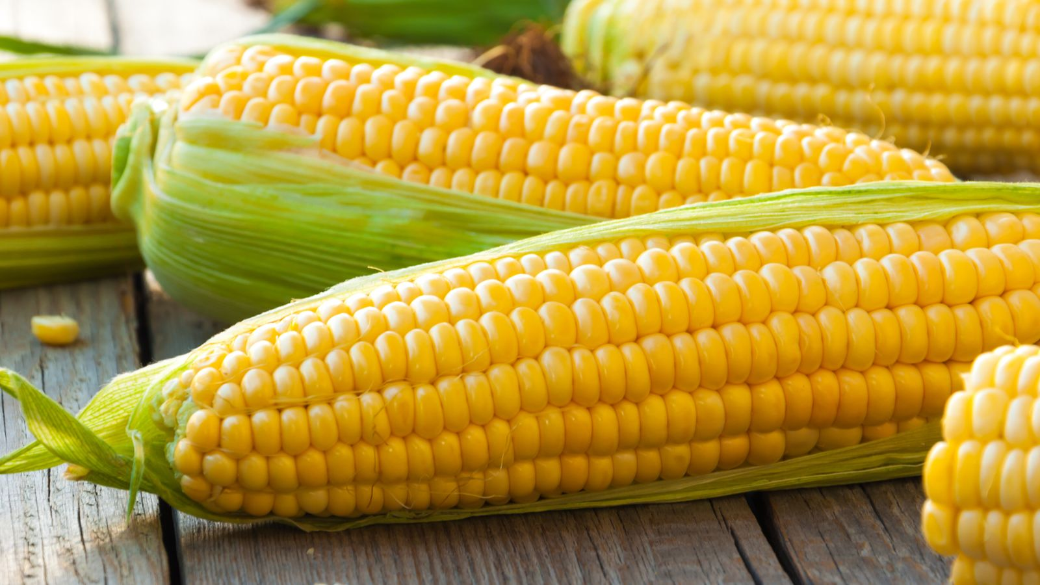
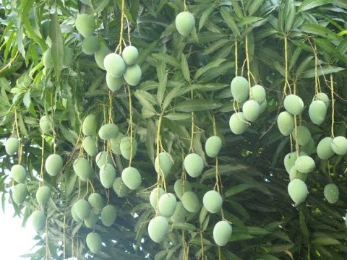
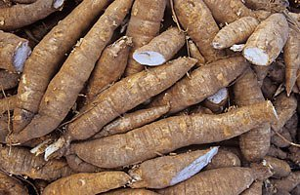

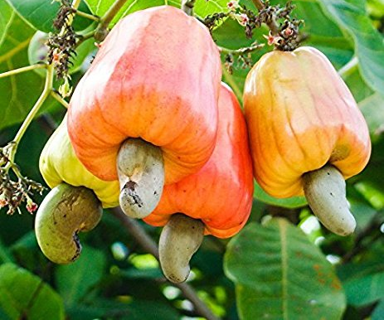
Ratio and Duration
TERA can use with any plants at any stages
with ratio from 150 to 250 cc Soluble in water 100 L / 1 Acre
The more concentrate, the more effective

